Slide 1
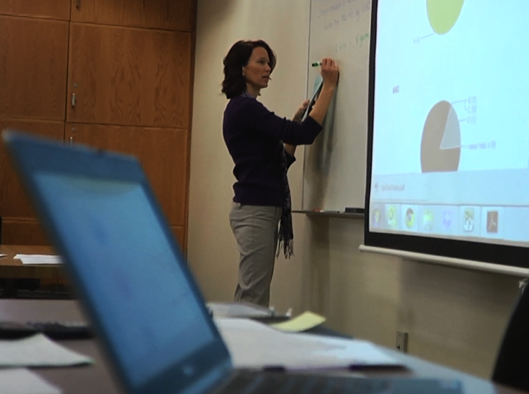
Improving Access, Affordability and Student Success with Open Educational Resources

Slide 2
Improving Access, Affordability and Student Success with Open Educational Resources
Josh Baron, Open Education Ambassador, Lumen Learning
Alexis Clifton, Course Design & Faculty Support Lead

Slide 3
Improving Access, Affordability and Student Success with Open Educational Resources
Setting the Context: Why is AtD doing this?
Pop Quiz! What is OER and Creative Commons?
Demonstration: The 5R’s in Action
Have we Built a Better Mouse Trap?
Demonstration: OER-based Personalized Learning
Successful High-Impact Scaling Strategies
Q & A as we go...

Slide 4
Why adopt OER?

Slide 5
New data from the Bureau of Labor Statistics finds that textbook prices have increased by 88% in the past decade, compared to a 63% increase in college tuition and fees.

Slide 6
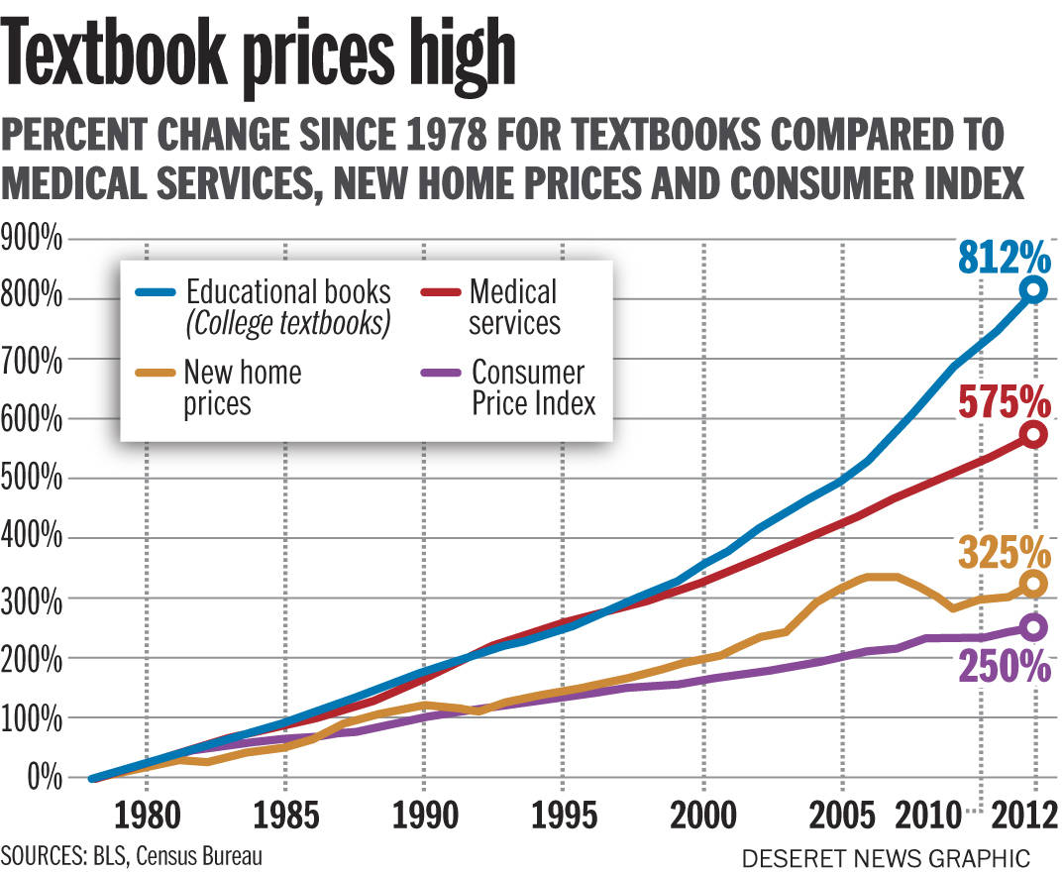
Notes:
This chart comes as no surprise to anyone working or participating in the U.S. higher education system in recent years. Since 1980, the cost of textbooks has outpaced even the skyrocketing cost of health care, not to mention new home prices and the consumer price index. It’s a problem, and part of the problem is that many students vote with their wallets and simply avoid buying textbooks.

Slide 7
Textbook cost impacts student success
Source: 2012 student survey by Florida Virtual Campus
60%+ do not purchase textbooks at some point due to cost
⓪①⓪①⓪①
35% take fewer courses due to textbook cost
①⓪①⓪
31% choose not to register for a course due to textbook cost
⓪①⓪①
23% regularly go without textbooks due to cost
①⓪①
⓪①
14% have dropped a course due to textbook cost
10% have withdrawn from a course due to textbook cost
①
Notes:
It turns out that textbook cost has a direct impact on students’ ability to succeed.
Recent research (conducted by the Florida Virtual Campus) quantifies the ways high textbook costs affect student persistence and success.
More than 60% of students report not having purchase textbooks at some point due to the cost
Nearly a quarter (23%) of students regularly go without textbooks due to their cost
Due to the high cost of textbooks:
35% of students report taking fewer courses
31% report not registering for a course
14% have dropped a course
10% have withdrawn from a course
Link to research source: http://www.openaccesstextbooks.org/pdf/2012_Exec_Sum_Student_Txtbk_Survey.pdf

Slide 8
Open Educational Resources
Notes:
Open educational resources, also called OER, are one solution to this complex problem of college affordability and student success. OER isn’t a magic bullet for every problem that ails higher education. But OER represent a powerful and underutilized solution for many students, faculty members and institutions.
OER demonstrate so much promise, in fact, that this is the solution to these problems that Lumen focuses on. A growing body of empirical research shows us that OER can remove barriers to and actually increase student success. When students have free, day one access to the materials they need to succeed, they perform better. And when they don’t have to buy expensive textbooks, many of them reinvest textbook cost savings in their educational path, taking more credits to complete college sooner. Instructors tell us students are more engaged in the course material in OER courses. You wonder why? Because they have the course materials. It’s not a mystery why they would engage and learn better when the can access the content.
CC BY image from https://www.flickr.com/photos/kretyen/2628104710

Slide 9
Open Educational Resources (OER)
Any kind of teaching materials
(e.g., textbooks, syllabi, lesson plans, images, videos, readings, quiz items, assignments, grading rubrics, etc.)
In the public domain or licensed to allow:
Free and unfettered access to anyone, and
Free permission to engage in the “5R activities”: Retain, reuse, revise, remix, redistribute
Notes:
Just to confirm what we mean when we say open educational resources, it’s worth briefly reviewing the definition. (see slide content)

Slide 10
The 5Rs
Reuse
Use in a wide range of ways
Revise
Adapt, modify, and improve
Remix
Share with others
Combine two or more
Redistribute
Retain
Make and own a copy
Notes:
NOTE: Mention INNOVATION ENGINE related to 5Rs.

Slide 12
By Giffin Francoeur - https://www.emaze.com/@AIZOWOCR/Creative-Commons!

Slide 13
free ≈ open
Notes:
The ENTIRE INTERNET is free

Slide 14
Demo: 5R in Action

Slide 15
Have we built a better mouse trap?

Slide 16
 | Cost to Students | Permissions to Faculty and Students
Commercial Textbooks | Expensive | Restrictive
Library Resources | Free | Restrictive
Open Educational Resources | Free | 5Rs
David Wiley, Why Should You Offer an OER Degree Program?
Notes:
When you think about this in terms of academic libraries and the academic setting, this table illustrates what we see today.
Only open educational resource are both freely available and provide these great 5R permissions that allow for broader and more creative use of educational content.

Slide 17
Free 5Rs
✔
✔
What about quality?

Slide 18
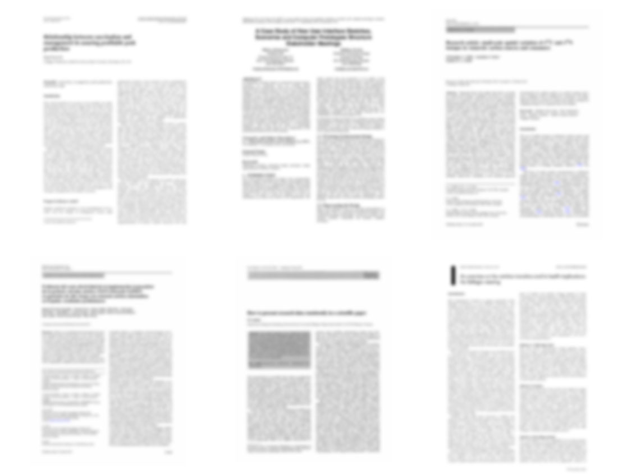
11 Peer Reviewed Studies
http://openedgroup.org/
Notes:
The Open Education Group, working out of Brigham Young University, as identified 11 peer-reviewed studies that together reflect the experiences of …
Across eleven academic studies that attempted to measure results pertaining to student learning (with 48,623 students participated) none showed results in which students who utilized OER performed worse than their peers who used traditional textbooks.
Allen, G., Guzman-Alvarez, A., Molinaro, M., Larsen, D. (2015). Assessing the Impact and Efficacy of the Open-Access ChemWiki Textbook Project. Educause Learning Initiative Brief, January 2015. See also this newsletter. Bowen, W. G., Chingos, M. M., Lack, K. A., & Nygren, T. I. (2012). Interactive Learning Online at Public Universities: Evidence from Randomized Trials. Ithaka S+R. Bowen, W. G., Chingos, M. M., Lack, K. A., & Nygren, T. I. (2014). Interactive Learning Online at Public Universities: Evidence from a Six‐Campus Randomized Trial. Journal of Policy Analysis and Management, 33(1), 94-111. Feldstein, A., Martin, M., Hudson, A., Warren, K., Hilton, J., & Wiley, D. (2012). Open textbooks and increased student access and outcomes. European Journal of Open, Distance and E-Learning. Retrieved from http://www.eurodl.org/index.php?p=archives&year=2012&halfyear=2&article=533. Gil, P., Candelas, F., Jara, C., Garcia, G., Torres, F (2013). Web-based OERs in Computer Networks. International Journal of Engineering Education, 29(6), 1537-1550. (OA preprint) Hilton, J., Gaudet, D., Clark, P., Robinson, J., & Wiley, D. (2013). The adoption of open educational resources by one community college math department. The International Review of Research in Open and Distance Learning, 14(4), 37–50. Hilton, J., & Laman, C. (2012). One college’s use of an open psychology textbook. Open Learning: The Journal of Open and Distance Learning, 27(3), 201–217. Retrieved from http://www.tandfonline.com/doi/abs/10.1080/02680513.2012.716657. (Open Repository Preprint). Lovett, M., Meyer, O., & Thille, C. (2008). The open learning initiative: Measuring the effectiveness of the OLI statistics course in accelerating student learning. Journal of Interactive Media in Education, 2008 (1). Pawlyshyn, Braddlee, Casper and Miller (2013). Adopting OER: A Case Study of Cross-Institutional Collaboration and Innovation. Educause Review. Robinson, T.J. (2015). Open Textbooks: The Effects of Open Educational Resource Adoption on Measures of Post-secondary Student Success (Doctoral dissertation). Robinson T. J., Fischer, L., Wiley, D. A., & Hilton, J. (2014). The impact of open textbooks on secondary science learning outcomes. Educational Researcher, 43(7): 341-351. Wiley, D., Hilton, J. Ellington, S., and Hall, T. (2012). “A preliminary examination of the cost savings and learning impacts of using open textbooks in middle and high school science classes.” International Review of Research in Open and Distance Learning. 13 (3), pp. 261-276.

Slide 19
48,623 Students
http://openedgroup.org/
Notes:
Just under 50,000 students …
Across eleven academic studies that attempted to measure results pertaining to student learning (with 48,623 students participated) none showed results in which students who utilized OER performed worse than their peers who used traditional textbooks.
Allen, G., Guzman-Alvarez, A., Molinaro, M., Larsen, D. (2015). Assessing the Impact and Efficacy of the Open-Access ChemWiki Textbook Project. Educause Learning Initiative Brief, January 2015. See also this newsletter. Bowen, W. G., Chingos, M. M., Lack, K. A., & Nygren, T. I. (2012). Interactive Learning Online at Public Universities: Evidence from Randomized Trials. Ithaka S+R. Bowen, W. G., Chingos, M. M., Lack, K. A., & Nygren, T. I. (2014). Interactive Learning Online at Public Universities: Evidence from a Six‐Campus Randomized Trial. Journal of Policy Analysis and Management, 33(1), 94-111. Feldstein, A., Martin, M., Hudson, A., Warren, K., Hilton, J., & Wiley, D. (2012). Open textbooks and increased student access and outcomes. European Journal of Open, Distance and E-Learning. Retrieved from http://www.eurodl.org/index.php?p=archives&year=2012&halfyear=2&article=533. Gil, P., Candelas, F., Jara, C., Garcia, G., Torres, F (2013). Web-based OERs in Computer Networks. International Journal of Engineering Education, 29(6), 1537-1550. (OA preprint) Hilton, J., Gaudet, D., Clark, P., Robinson, J., & Wiley, D. (2013). The adoption of open educational resources by one community college math department. The International Review of Research in Open and Distance Learning, 14(4), 37–50. Hilton, J., & Laman, C. (2012). One college’s use of an open psychology textbook. Open Learning: The Journal of Open and Distance Learning, 27(3), 201–217. Retrieved from http://www.tandfonline.com/doi/abs/10.1080/02680513.2012.716657. (Open Repository Preprint). Lovett, M., Meyer, O., & Thille, C. (2008). The open learning initiative: Measuring the effectiveness of the OLI statistics course in accelerating student learning. Journal of Interactive Media in Education, 2008 (1). Pawlyshyn, Braddlee, Casper and Miller (2013). Adopting OER: A Case Study of Cross-Institutional Collaboration and Innovation. Educause Review. Robinson, T.J. (2015). Open Textbooks: The Effects of Open Educational Resource Adoption on Measures of Post-secondary Student Success (Doctoral dissertation). Robinson T. J., Fischer, L., Wiley, D. A., & Hilton, J. (2014). The impact of open textbooks on secondary science learning outcomes. Educational Researcher, 43(7): 341-351. Wiley, D., Hilton, J. Ellington, S., and Hall, T. (2012). “A preliminary examination of the cost savings and learning impacts of using open textbooks in middle and high school science classes.” International Review of Research in Open and Distance Learning. 13 (3), pp. 261-276.
person icon by Ferran Brown from the Noun Project

Slide 20
93% Same or Better Outcomes
http://openedgroup.org/
Notes:
Across eleven academic studies that attempted to measure results pertaining to student learning (with 48,623 students participated) none showed results in which students who utilized OER performed worse than their peers who used traditional textbooks.
Allen, G., Guzman-Alvarez, A., Molinaro, M., Larsen, D. (2015). Assessing the Impact and Efficacy of the Open-Access ChemWiki Textbook Project. Educause Learning Initiative Brief, January 2015. See also this newsletter. Bowen, W. G., Chingos, M. M., Lack, K. A., & Nygren, T. I. (2012). Interactive Learning Online at Public Universities: Evidence from Randomized Trials. Ithaka S+R. Bowen, W. G., Chingos, M. M., Lack, K. A., & Nygren, T. I. (2014). Interactive Learning Online at Public Universities: Evidence from a Six‐Campus Randomized Trial. Journal of Policy Analysis and Management, 33(1), 94-111. Feldstein, A., Martin, M., Hudson, A., Warren, K., Hilton, J., & Wiley, D. (2012). Open textbooks and increased student access and outcomes. European Journal of Open, Distance and E-Learning. Retrieved from http://www.eurodl.org/index.php?p=archives&year=2012&halfyear=2&article=533. Gil, P., Candelas, F., Jara, C., Garcia, G., Torres, F (2013). Web-based OERs in Computer Networks. International Journal of Engineering Education, 29(6), 1537-1550. (OA preprint) Hilton, J., Gaudet, D., Clark, P., Robinson, J., & Wiley, D. (2013). The adoption of open educational resources by one community college math department. The International Review of Research in Open and Distance Learning, 14(4), 37–50. Hilton, J., & Laman, C. (2012). One college’s use of an open psychology textbook. Open Learning: The Journal of Open and Distance Learning, 27(3), 201–217. Retrieved from http://www.tandfonline.com/doi/abs/10.1080/02680513.2012.716657. (Open Repository Preprint). Lovett, M., Meyer, O., & Thille, C. (2008). The open learning initiative: Measuring the effectiveness of the OLI statistics course in accelerating student learning. Journal of Interactive Media in Education, 2008 (1). Pawlyshyn, Braddlee, Casper and Miller (2013). Adopting OER: A Case Study of Cross-Institutional Collaboration and Innovation. Educause Review. Robinson, T.J. (2015). Open Textbooks: The Effects of Open Educational Resource Adoption on Measures of Post-secondary Student Success (Doctoral dissertation). Robinson T. J., Fischer, L., Wiley, D. A., & Hilton, J. (2014). The impact of open textbooks on secondary science learning outcomes. Educational Researcher, 43(7): 341-351. Wiley, D., Hilton, J. Ellington, S., and Hall, T. (2012). “A preliminary examination of the cost savings and learning impacts of using open textbooks in middle and high school science classes.” International Review of Research in Open and Distance Learning. 13 (3), pp. 261-276.
person icon by Ferran Brown from the Noun Project

Slide 21
Personalized-Learning
Efficacy
Big Finding #1
In Waymaker sections, a higher percentage of students complete the course, compared to control sections.
Big Finding #2
Waymaker sections erase the performance gap for Pell-eligible students that is evident in control sections.
Waymaker Spring Learning Data
Waymaker Spring Learning Data
Notes:
Note: “Control” sections use a variety of required course materials. Some use commercial textbooks. Others use OER textbooks.

Slide 22
9 Peer Reviewed Studies of Perceptions of OER Quality
http://openedgroup.org/
Notes:
There are also studies about perceptions of the quality of open educational resources …
In terms of student and teacher perceptions of OER, 2,366 students and 2,144 faculty members were surveyed across the nine peer-reviewed studies. Approximately 50% said that the OER resources were as good as traditional resources, 35% said the OER were superior and 15% said they were inferior.
Allen, I., Seaman, J. (2014). Opening the Curriculum: Open Educational Resources in U.S. Higher Education, 2014. Bliss, T., Robinson, T. J., Hilton, J., & Wiley, D. (2013). An OER COUP: College teacher and student perceptions of Open Educational Resources. Journal of Interactive Media in Education, 1–25. Bliss, T., Hilton, J., Wiley, D., Thanos, K. (2013). The cost and quality of open textbooks: Perceptions of community college faculty and students. First Monday, 18:1. Feldstein, A., Martin, M., Hudson, A., Warren, K., Hilton, J., & Wiley, D. (2012). Open textbooks and increased student access and outcomes. European Journal of Open, Distance and E-Learning. Retrieved from http://www.eurodl.org/index.php?p=archives&year=2012&halfyear=2&article=533. Gil, P., Candelas, F., Jara, C., Garcia, G., Torres, F (2013). Web-based OERs in Computer Networks. International Journal of Engineering Education, 29(6), 1537-1550. (OA preprint). Hilton, J., Gaudet, D., Clark, P., Robinson, J., & Wiley, D. (2013). The adoption of open educational resources by one community college math department. The International Review of Research in Open and Distance Learning, 14(4), 37–50. Lindshield, B., & Adhikari, K. (2013). Online and campus college students like using an open educational resource instead of a traditional textbook. Journal of Online Learning & Teaching, 9(1), 1–7. Petrides, L., Jimes, C., Middleton‐Detzner, C., Walling, J., & Weiss, S. (2011). Open textbook adoption and use: Implications for teachers and learners. Open learning, 26(1), 39-49, Pitt, R., Ebrahimi, N., McAndrew, P., & Coughlan, T. (2013). Assessing OER impact across organisations and learners: experiences from the Bridge to Success project. Journal of Interactive Media in Education, 2013(3).

Slide 23
4,510 Professors and Students
http://openedgroup.org/
Notes:
In terms of student and teacher perceptions of OER, 2,366 students and 2,144 faculty members were surveyed across the nine peer-reviewed studies. Approximately 50% said that the OER resources were as good as traditional resources, 35% said the OER were superior and 15% said they were inferior.
Allen, I., Seaman, J. (2014). Opening the Curriculum: Open Educational Resources in U.S. Higher Education, 2014. Bliss, T., Robinson, T. J., Hilton, J., & Wiley, D. (2013). An OER COUP: College teacher and student perceptions of Open Educational Resources. Journal of Interactive Media in Education, 1–25. Bliss, T., Hilton, J., Wiley, D., Thanos, K. (2013). The cost and quality of open textbooks: Perceptions of community college faculty and students. First Monday, 18:1. Feldstein, A., Martin, M., Hudson, A., Warren, K., Hilton, J., & Wiley, D. (2012). Open textbooks and increased student access and outcomes. European Journal of Open, Distance and E-Learning. Retrieved from http://www.eurodl.org/index.php?p=archives&year=2012&halfyear=2&article=533. Gil, P., Candelas, F., Jara, C., Garcia, G., Torres, F (2013). Web-based OERs in Computer Networks. International Journal of Engineering Education, 29(6), 1537-1550. (OA preprint). Hilton, J., Gaudet, D., Clark, P., Robinson, J., & Wiley, D. (2013). The adoption of open educational resources by one community college math department. The International Review of Research in Open and Distance Learning, 14(4), 37–50. Lindshield, B., & Adhikari, K. (2013). Online and campus college students like using an open educational resource instead of a traditional textbook. Journal of Online Learning & Teaching, 9(1), 1–7. Petrides, L., Jimes, C., Middleton‐Detzner, C., Walling, J., & Weiss, S. (2011). Open textbook adoption and use: Implications for teachers and learners. Open learning, 26(1), 39-49, Pitt, R., Ebrahimi, N., McAndrew, P., & Coughlan, T. (2013). Assessing OER impact across organisations and learners: experiences from the Bridge to Success project. Journal of Interactive Media in Education, 2013(3).
person icon by Ferran Brown from the Noun Project

Slide 24
15%
Worse
35%
Better
http://openedgroup.org/
Notes:
In summary … about half feel the quality is about the same as what they were using before. Just over a third say it’s better.
In terms of student and teacher perceptions of OER, 2,366 students and 2,144 faculty members were surveyed across the nine peer-reviewed studies. Approximately 50% said that the OER resources were as good as traditional resources, 35% said the OER were superior and 15% said they were inferior.
Allen, I., Seaman, J. (2014). Opening the Curriculum: Open Educational Resources in U.S. Higher Education, 2014. Bliss, T., Robinson, T. J., Hilton, J., & Wiley, D. (2013). An OER COUP: College teacher and student perceptions of Open Educational Resources. Journal of Interactive Media in Education, 1–25. Bliss, T., Hilton, J., Wiley, D., Thanos, K. (2013). The cost and quality of open textbooks: Perceptions of community college faculty and students. First Monday, 18:1. Feldstein, A., Martin, M., Hudson, A., Warren, K., Hilton, J., & Wiley, D. (2012). Open textbooks and increased student access and outcomes. European Journal of Open, Distance and E-Learning. Retrieved from http://www.eurodl.org/index.php?p=archives&year=2012&halfyear=2&article=533. Gil, P., Candelas, F., Jara, C., Garcia, G., Torres, F (2013). Web-based OERs in Computer Networks. International Journal of Engineering Education, 29(6), 1537-1550. (OA preprint). Hilton, J., Gaudet, D., Clark, P., Robinson, J., & Wiley, D. (2013). The adoption of open educational resources by one community college math department. The International Review of Research in Open and Distance Learning, 14(4), 37–50. Lindshield, B., & Adhikari, K. (2013). Online and campus college students like using an open educational resource instead of a traditional textbook. Journal of Online Learning & Teaching, 9(1), 1–7. Petrides, L., Jimes, C., Middleton‐Detzner, C., Walling, J., & Weiss, S. (2011). Open textbook adoption and use: Implications for teachers and learners. Open learning, 26(1), 39-49, Pitt, R., Ebrahimi, N., McAndrew, P., & Coughlan, T. (2013). Assessing OER impact across organisations and learners: experiences from the Bridge to Success project. Journal of Interactive Media in Education, 2013(3).

Slide 25
Free ✔ 5Rs ✔ Quality ✔

Slide 26
WARNING: Ethical Dilemma Coming Your Way!

Slide 27
Strategies and Impact from the Real World

Slide 28
Monroe Community College
Complete OER Migration & Customization of a High-impact Course
Goals:
Reduce cost to students
Increase access to essential content
Make content more relevant, useful
Process:
Project led by library
Significant localization: “College Success at Monroe CC”
Print required, with full course catalog embedded
Results
Full adoption of OER for all sections of College Success
Enrolled all underprepared first-year students
Retention up 15%
Cost to students down to $18 from $141
Free digital + low-cost print book
Notes:
Seeking ways to lower barriers for students and improve the effectiveness of its College Success course, Monroe Community College (MCC) assembled a collaborative team to redesign the course using open educational resources (OER) and move dozens of instructors and hundreds of students to more relevant, lower-cost materials. They started with an openly-licensed College Success textbook and customized it to reflect what they wanted incoming Monroe CC students to know and understand about being successful at their institution. It covered not only study skills and how college works, but also what resources are available at Monroe to support students and help them achieve their goals. The project brought stakeholders on board from the library, bookstore, student services, faculty and executive leadership to contribute to the success of this initiative. Together they navigated administrative considerations including budget, course fee structure, and faculty training and support for course design and instruction using OER. The bookstore provides a low-cost, hard-copy textbook, and materials are free online. Building on this success, MCC is pursuing a similar, collaborative model to transition other high-enrollment courses to OER.

Slide 29
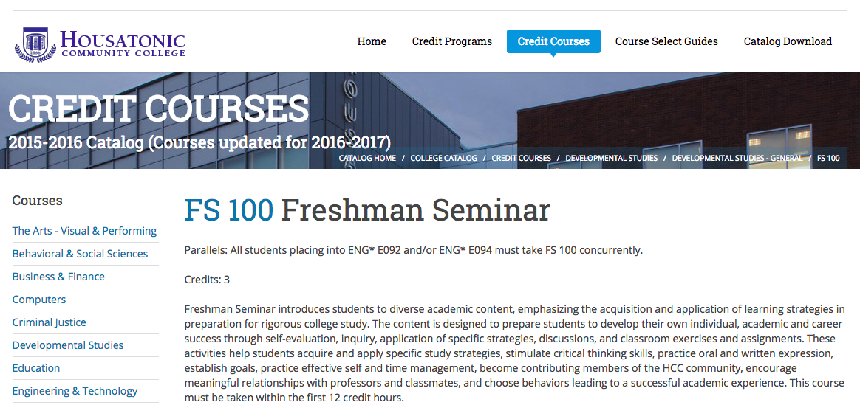
Would a customized College Success textbook be useful in your Freshman Seminar course?

Slide 30
Strategy #2
Make OER part of a broader strategic initiative around affordability, access, success
Examples:
OER degree programs
Departmental differentiation and branding
Developmental education makeover
Overcome These Obstacles
✓
✓
Awareness
Faculty buy-in
Islands and isolation
Growing beyond a toehold
Bookstore
Departmental support
Administrative support
✓
✓
✓
✓
✓
✓
✓
Notes:
Build OER into a broader initiative around affordability, access, student success: OER degree program.

Slide 31
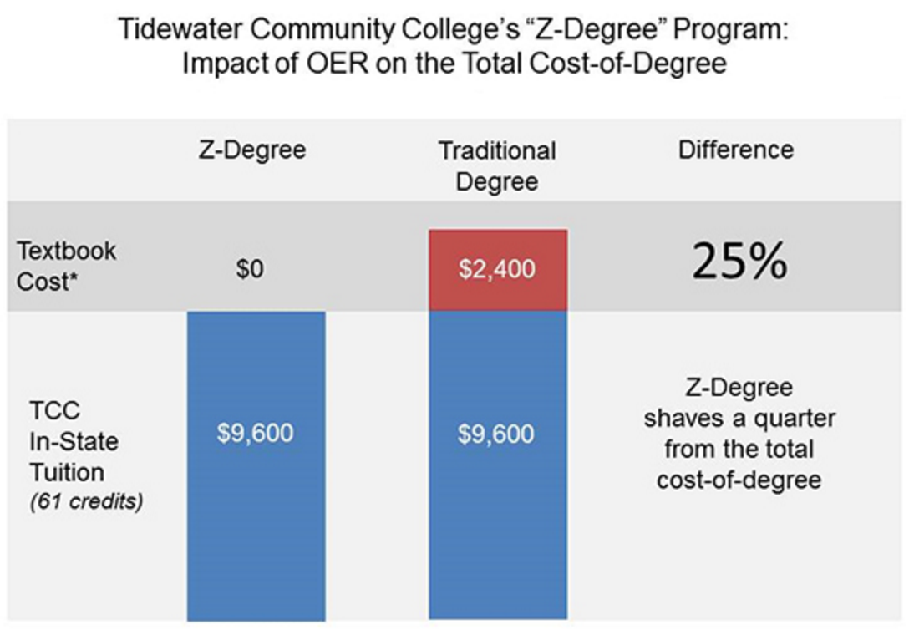
OER-based Degrees
Notes:
http://web.tcc.edu/academics/zdegree/

Slide 32
Would your students like 23% off per year?
23% Reduction in Student Cost PER YEAR

Slide 33
Discussion and Q&A
Strategic Goals and Intersections with OER Adoption

Slide 34
Lumen Learning and Supporting OER Adoption at Scale

Slide 35
About Lumen Learning
Focus: Improve student success using OER
founders: David Wiley & Kim Thanos
mission: Scale effective use of OER and personalized learning
Improve access and quality
Impact disadvantaged learners
Create next generation OER
approach: Model Openness
Respect and built community
Continuous improvement
Openly license and share (CC-BY)
Facts
Formed in 2012
Based in Portland, OR
80+ institutional clients
27 team members
Support from Hewlett, Gates & Shuttleworth Foundations
Notes:
Very briefly, Lumen is a company that was created to support institutions in adopting OER. As we have worked with institutions around the country in evaluating and using OER course materials we have identified a range of opportunities to improve and enhance the OER to support a greater level of interactivity and success. We are excited about these Waymaker courses as an opportunity to expand our OER work.

Slide 36
Benefits of working with Lumen Learning
Alignment with outcomes
Data-driven continuous improvement
Faculty-student connection
Curated, updated content
License clearance & attribution
Ancillaries
Content
Learning
Design
Technology
LMS integration
Editing tools (5R’s)
Export to PDF and EPUB
Personalized learning capabilities
Faculty dashboard with recommendations
Support

Slide 37
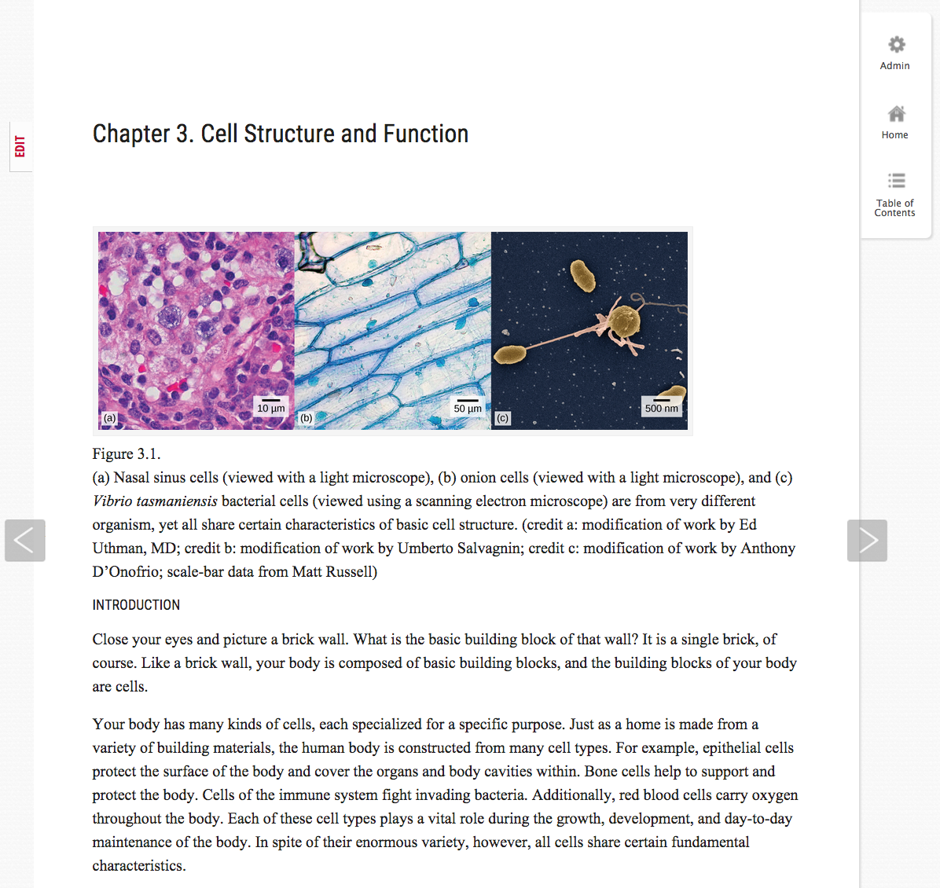
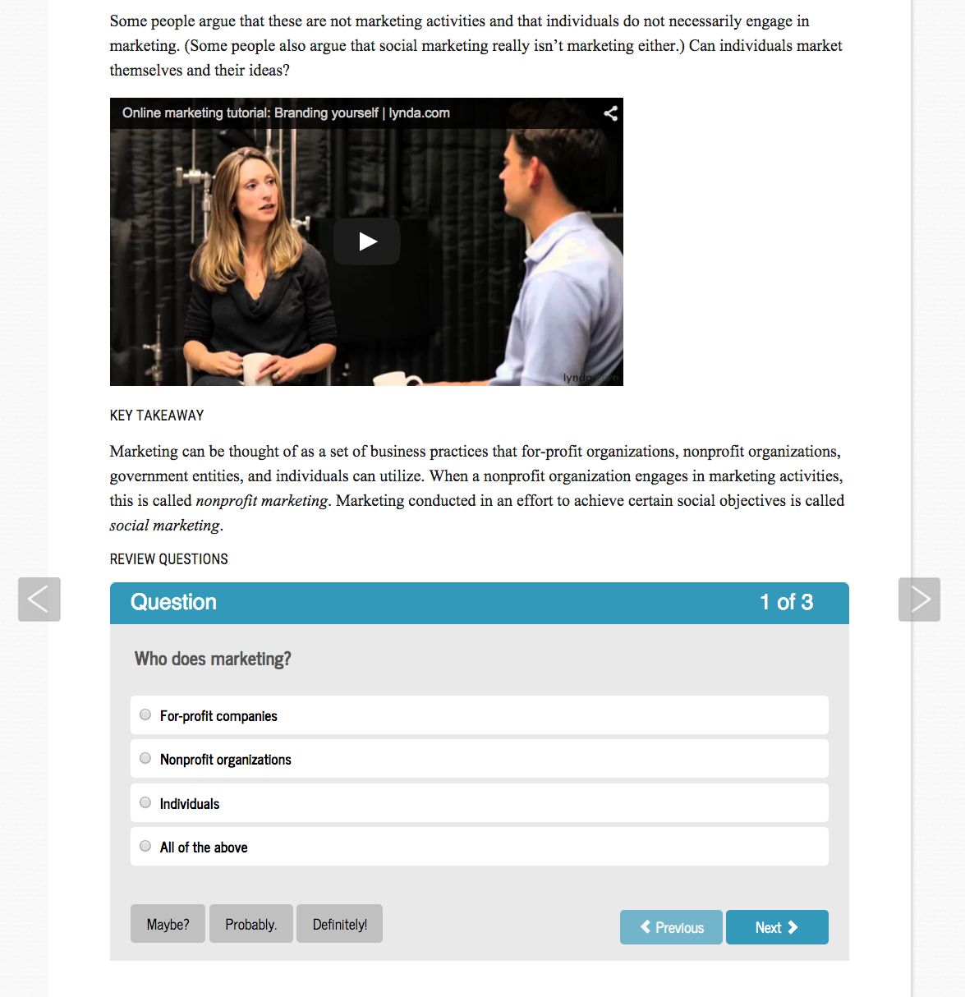
Candela Courses
A great starting point for adopting, adapting and collaborating
Complete customization (5R’s)
Curated (best prior work of peers)
Quiz question banks and sample assessments
Seamless LMS delivery
Faculty and tech support
65+ high-enrollment college subjects
Notes:
Going into a little more detail on each of these offerings:
Candela courses offer a great, well-supported starting point for faculty members to adopt, customize and teach OER courses. They’re developed and curated, building on the best prior work of peers. Instructors can retain, reuse, revise, remix and redistribute course content however they like. Students and instructors access all digital course materials right inside the LMS course shell. PDF and EPUB formats are also available for offline access to course materials. Supplemental materials like quiz banks, sample assessments and assignments, study guides, video and so forth are typically incorporated into course design.
Candela courses are available for 65+ high-enrollment college subjects across many disciplines. Lumen’s low-cost support fee for Candela courses is $10 per student enrollment in sections using Lumen-supported materials.

Slide 38
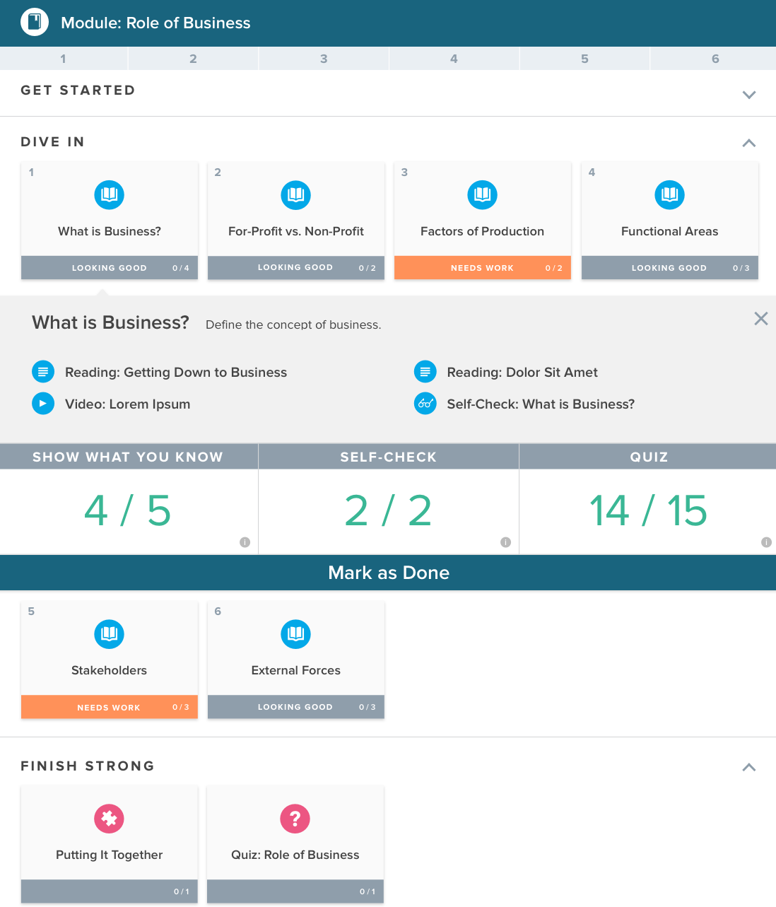
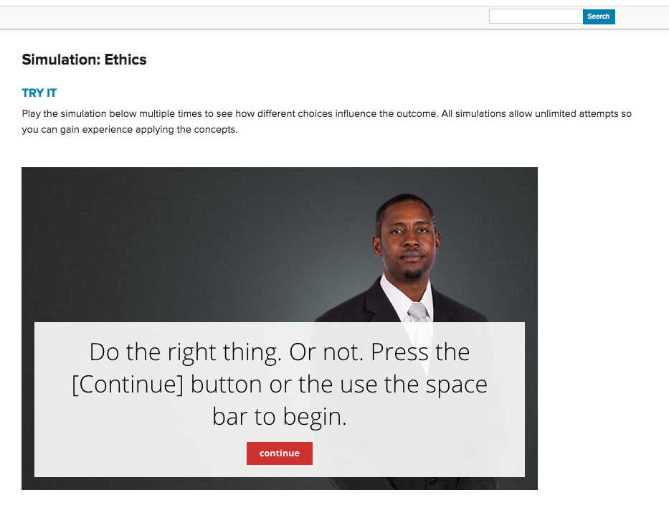
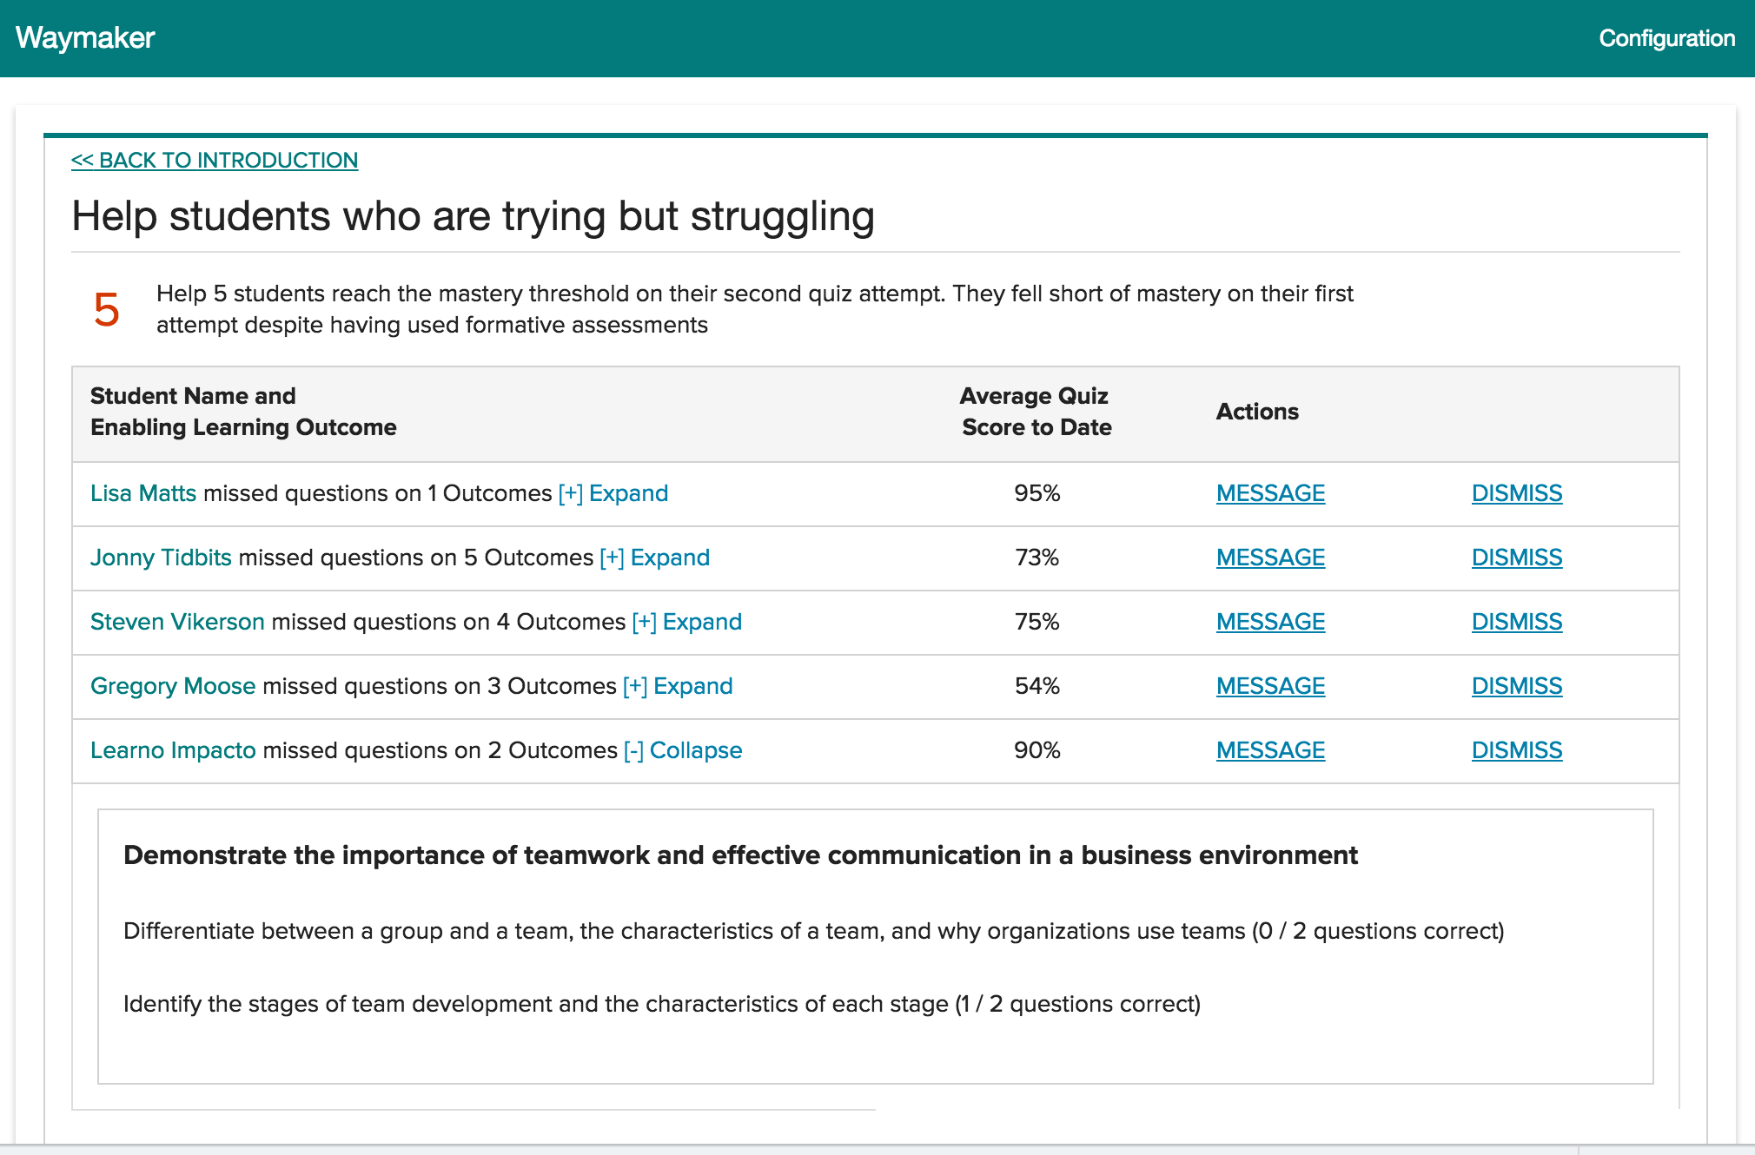
Waymaker Courses
OER courses with a personalized learning approach
all features of Candela courses plus:
mastery learning
individualized feedback
learner agency & metacognition
faculty-student connection
Notes:
Waymaker courses offer all the features of Candela courses, in addition to four research-based interventions designed to personalize the learning experience for each student:
A mastery learning assessment approach uses assessments as learning activities, not just measurement activities. As students work through the course content, they have multiple attempts to perform the assessment, get individualized feedback, learn from this experience and then resubmit to improve their learning and performance.
Individualized feedback is also build into how students interact with the content itself, through a personalized study plan that provides guidance for students on where to focus to improve their learning.
This guidance and feedback give students the opportunity to make better choices about their learning activities as they learn to become better learners.
Finally, Waymaker courses provide recommendations to alert instructors when and how to help struggling students, along with time-saving, automated messaging tools to offer encouragement, coaching and individualized outreach when needed.
Waymaker courses have a $25 support fee per student enrolled in sections using Waymaker materials. For fall 2016 we offer Waymaker courses in four subjects, and we’re in the process of building out our Waymaker catalog.

Slide 39
Discussion and Q&A
Strategic Goals and Intersections with OER Adoption

Slide 40
Achieving the Dream Program Requirements

Slide 41
WARNING We are building this aircraft as we are flying it!
Check in often and watch for updates!

Slide 42
What does my AtD Course Need to Include?
Open Courses vs. Open Textbooks
Your OER course should include everything an other instructor would need to teach the course, such as:
Assignments
Test Questions
Discussion Topics
PowerPoint Slides

Slide 43
HELPFUL TIP: Adopt existing OER whenever possible, build only when absolutely necessary.

Slide 44
What Licensing Guidelines Do I Need to Follow?
Any new OER materials that you develop must be licensed as CC-BY (Attribution Only)
Any existing OER materials that are used must follow the AtD Licensing Guidelines (see handout)
Supplemental Materials Litmus Test: Can someone still teach the course if the content goes away? Can students still meet the learning objectives?

Slide 46
What if my course is about Catcher in the Rye?
If your course is about an “artifact” that is All Rights Reserved copyright protected you can request an exemption.
To request and exemption complete the form at: https://www.surveymonkey.com/r/artifact-exception
IMPORTANT: Journal articles, videos, that picture that you just love to use, etc. generally will not qualify

Slide 47
How will licensing be verified?
AtD is requiring that all OER degree courses be verified by Lumen Learning as “open”
This is will provide legal protection for everyone
To have your course certified you will need to complete a Course Map:
Learning objectives
OER content to be used and links to it
How content is licensed
Course Maps for Spring 17 are due by the end of November

Slide 48
HELPFUL TIP: Start your work by creating a Course Map

Slide 49
How will OER Course be Shared with Others?
By the end of the grant all OER Courses must be transferred to the Lumen Learning Public Course Catalog
This content will always be FREELY available under and open license
Lumen staff will work to migrate content to our platform (if its is not already there)

Slide 50
Discussion and Q&A
AtD OER Degree Program

Slide 51
5R Hands-On Activity

Slide 52
Supporting OER Adoption

Slide 53
Supporting OER Adoption
Topics to Review
Waymaker Demo: OER-based Personalized Learning
Using Course Maps to Support OER Curation
Overview of Lumen Support Services
Examples of LibGuides for OER
Faculty Collaboration in OER Communities
These are meant to stimulate a discussion of how to best support faculty at TC3

Slide 54
Waymaker: OER-based Personalized Learning

Slide 55
About Waymaker
Next Generation Courseware Challenge: Grant program funded by the Gates Foundation
Program Goal: Develop affordable, high quality digital course materials to improve teaching and learning for disadvantaged learners
Waymaker Goal: Deliver highly effective, personalized learning experiences using OER
Notes:
The initial design and development of the Waymaker courses was funded by a grant from the Gates Foundation. That program, broadly, is seeking to raise the bar on the quality and affordability of learning solutions that best support disadvantaged learners. As we created our proposal and completed the design work we had significant latitude in how to take that on. Our work was informed by the hundreds of faculty members that we had worked with across the country as they worked to move their courses to OER.

Slide 56
Waymaker’s Research-based Interventions
OER meets personalized learning
Open Educational Resources (OER)
1
Day 1 access; a fraction of the cost of traditional textbooks
2
Mastery Learning
Assessment as a learning activity; frequent feedback; strong alignment to learning outcomes
Personalization
3
Metacognition: coach students on where to focus; learn how to learn
4
Faculty-student Connection
Nurturing the learning process; individualized outreach & intervention
Notes:
It was also informed by learning science research. Our goal with the Waymaker courses is to make it easier for faculty members to use the practices that show greatest promise of increasing students success. We chose 4 primary focus areas to inform the design.
OER: We know well, from our work, that OER provide important opportunities for day 1 access to materials and reduced textbook costs. They also provide immense flexibility in revising and remixing the materials to take advantage of new pedagogy and technologies.
Mastery Learning allows students to master key concepts before they move ahead. In this implementation we have not focused on gating student progress, as our faculty partners told us this made it too difficult for them to stay connected to students who are moving all over the course. Instead, we have focused on giving students constant feedback into their level of mastery so they know exactly how much effort is needed to achieve the student learning outcome.
Initially, we had planned to implement a highly adaptive delivery of the content, but based on input from students and faculty, as well as learning research, we changed course. We are not using the student learning data to help the system get smarter about what the student needs. Instead, we are using providing that information back to the student so that the student is becoming a better learner. The system coaches the student on where to focus, and provides the faculty member with information to easily participate in that coaching.
Throughout the design we have placed an emphasis on the personal, human connection between the learner and the teacher. We are seeking to help faculty members make the most efficient use of their time, helping them answer the question, “If I have one hour to spend to help my students perform better, where will it make the biggest difference.”

Slide 57
Waymaker
Efficacy
Big Finding #1
In Waymaker sections, a higher percentage of students complete the course, compared to “control” sections.
Big Finding #2
Waymaker sections erase the performance gap for Pell-eligible students that is evident in “control” sections.
Waymaker Spring Learning Data
Waymaker Spring Learning Data
Notes:
Note: “Control” sections use a variety of required course materials. Some use commercial textbooks. Others use OER textbooks.

Slide 58
Waymaker Demo: College Success

Slide 59
Course Maps for OER Curation
Supports a “Backward Design” Approach
Start with Learning Objectives
Identify Assessments for Measuring Learning
Identify OER Aligned w/ Objectives and Assessments
Helps Faculty Track and Confirm CC Licenses
Reminder: Its important for faculty to attribute original authors to fulfill CC legal requirements
Consider using a Google Spreadsheet to Facilitate Collaboration and Support

Slide 60
Let’s take a look at some example…
Go to: lumenlearning.com/sunytc3/
And click on Course Mapping Template

Slide 61
Lumen Support Services – Help for the Helpers!

Slide 62
Lumen Support Services – Help for the Helpers!
Lumen Support Desk: support.lumenlearning.com
User Guide – How to instructions on a range of topics
Submit Support Request
Technical Questions
Finding OER
Licensing Questions
Office Hours: lumenlearning.com/office-hours
Offered daily online (M-F)
No need to register in advance
Great for one-on-one live help

Slide 63
OER LibGuides

Slide 64
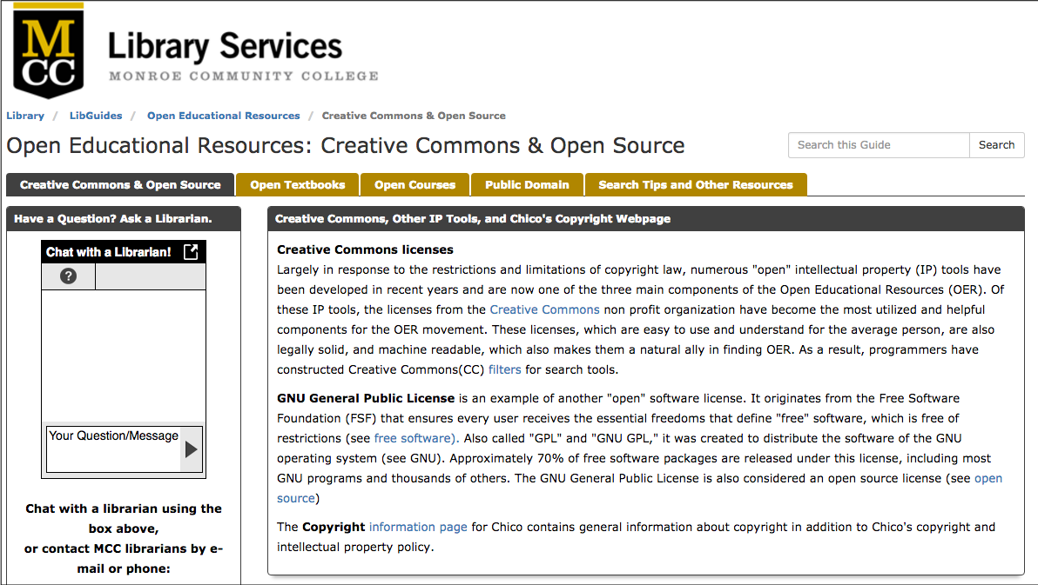
http://libguides.monroecc.edu/oer

Slide 65
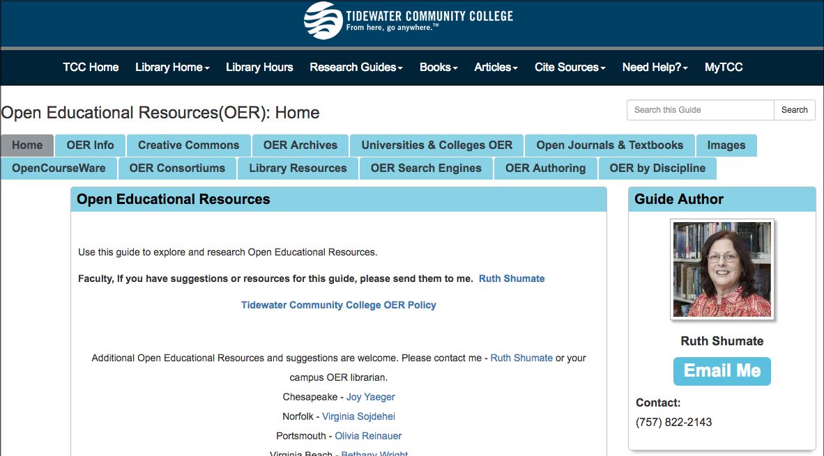
http://libguides.tcc.edu/c.php?g=304199&p=2028752

Slide 66
Faculty Collaboration: Communities of Practice

Slide 67
Faculty Collaboration: Communities of Practice
OER Communities of Practice
Can be based subject–based or cross disciplinary
Can include librarians and instructional designers
Can be focused on OER curation or development
Helps to drive innovation and reduce workload
Lumen is working to form national communities
Part of the Achieving the Dream OER Degree program
Initial community information at: courses.lumenlearning.com/coursesupport

