Slide 1
E
Metropolitan Community College
October 17, 2017
Every student deserves to experience the joy of learning.
Kim Thanos, Lumen Learning

Slide 2
Our Purpose
Make great learning opportunities available to all students, regardless of socioeconomic background.
We do this through effective adoption of open educational resources.
Facts
team of educators, instructional designers, learning scientists, entrepreneurs
based in Portland, OR
100+ institutional clients
$5 million+ in textbook savings in AY 2015-16
Develop
Notes:
What is Lumen

Slide 3
Open Educational Resources
Open educational resources (OER) are resources
that reside in the public domain
or have been released under an intellectual property license that permits their
free use and re-purposing by others.
Benefits include:
Students have day 1 access
Students can retain access to learning materials beyond the course
Faculty have greater freedom and control
Success and retention improve
Develop
Notes:
What is Lumen

Slide 4
OER Is Like Sunlight: A Public Good
Lumen does for OER
what solar companies do for sunlight:
Lumen : OER :: Solar Companies : Sunlight
Develop
Harness OER. To power student learning.
Notes:
What is Lumen

Slide 5
textbook market is broken
Photo by Nick Jio on Unsplash

Slide 6
Symptoms of a broken model
26%
Drop a course due to high textbook cost
38%
Earn a poor grade because of textbook cost
48%
Take fewer courses due to textbook costs
60%
Students go without textbooks due to cost
10%
20%
30%
40%
50%
60%
70%
80%
90%

Slide 7
~40%
of community college students graduate in 6 years
Notes:
For many, the barriers are simply too great. (Keep in mind these are 2 year degrees)
https://www.insidehighered.com/quicktakes/2015/03/09/community-college-enrollment-and-completion-data

Slide 8
800%
Notes:
The cost of textbooks is a big part of the problem. About ¼ of in-state tuition (4-year), ¾ of community college tuition.
The US Government Accountability Office (GAO) estimates that the cost of textbooks is comparable to 26% of in-state tuition at public universities and 72% at community colleges – up over 800% over the past three decades. Students literally drop out of post-secondary programs because of the cost of textbooks, while others simply forego purchasing required textbooks and suffer the academic consequences. In addition to negatively impacting individual students, the high costs and strict copyrights of educational materials slow the pace of educational innovation and experimentation.

Slide 9
⅔
don’t purchase required textbook
Notes:
The cost of textbooks is negatively impacting student access to required materials (66.6% did not purchase the required textbook) and learning (37.6% earn a poor grade; 19.8% fail a course).
https://florida.theorangegrove.org/og/file/3a65c507-2510-42d7-814c-ffdefd394b6c/1/2016%20Student%20Textbook%20Survey.pdf

Slide 10
20%
fail because they don’t
Notes:
The cost of textbooks is negatively impacting student access to required materials (66.6% did not purchase the required textbook) and learning (37.6% earn a poor grade; 19.8% fail a course).
https://florida.theorangegrove.org/og/file/3a65c507-2510-42d7-814c-ffdefd394b6c/1/2016%20Student%20Textbook%20Survey.pdf

Slide 11
OER Improves Student Success
OER Courses
Traditional Courses
4% increase in passing rates
8% reduction in drops and W’s
18% more credits this term
22% more credits next term
Develop
Sample: 4,909 open course students, 11,818 traditional course students, 50 different undergraduate courses, 130 teachers, 8 institutions in 2014-2015 academic year.
Method: Quasi-experimental design with: Propensity Score Matching, Post Test Only.
Dependent variables: Completion; C or Better; Credits Enrolled This Term; Next Term, Independent variable: Textbook condition, 3 covariates: including age, gender, and race.
Notes:
These are results from research conducted among institutions that offer Lumen-supported OER courses, across 8 institutions, 50 courses and more than 15,000 students. Here, we’re comparing several student success metrics between OER courses (in red) and traditional courses that do not use OER (in blue). The evidence is compelling: OER courses saw significantly higher passing rates, significantly lower drops and withdrawal rates, and students registered for more credits in the current and next terms, which bodes well for college completion rates.

Slide 12
Impact: Enrollments Supported in OER Courses
Candela

Slide 13
OER as an Tool to Enable Student Success
Faculty development
Faculty support
Content currency and enhancements
Accessibility
OER
Content
Learning
Design
Technology
(w/LMS)

Slide 14
Flexible Choices for OER Courses
Candela
(78 subjects)
Waymaker
(21 subjects)
Lumen OHM
(12 subjects)
eTextbook replacement with enriched OER
Simple, powerful personalized learning with enriched OER
OER online homework system for math, quantitative subjects
Notes:
Faculty can adopt any of the three OER course types you see here: Candela, Waymaker (which we’ll be taking a closer look at today) and OHM, the open math solution. Each provides options for a number of course areas. You’ll also receive a follow up email that will provide information on how you can get your own copies, ready-to-go in your LMS, for use this fall, spring and beyond.
I’ll now briefly explain what each of these course types entails, then introduce Julie for a deep dive into Waymaker for Intro Psych.

Slide 15
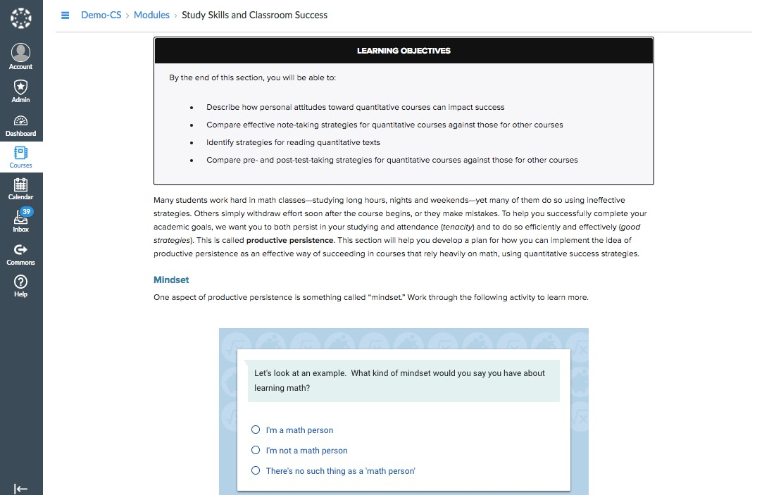
Candela Courses
OER text, video, images
Interactives
Quiz banks
Instructor resources
Easy Blackboard integration
$10
78 Subjects
Notes:
Lumen’s Candela courses offer an easy-to-adopt alternative to expensive commercial textbooks in high enrollment college courses. Candela courses are a great starting point for shifting high-enrollment courses to OER, because they offer customizable e-textbook replacement for 70+ high-enrollment college subjects.
What we offer.
Candela courses are complete digital courses that offer customizable OER to replace traditional textbooks. You might think of these as comparable to publisher’s traditional textbooks: no better, no worse.
Waymaker courses are complete digital courses designed around a personalized learning pedagogy and toolset. With these courses, we’ve taken the learning design several steps further, with the goal of creating a more powerful, more effective learning experience for students using OER.
Lumen’s Online Homework Manager (OHM) provides instructional content, online practice problems and assessments for many college math courses. Lumen courses combine the flexibility of open educational resources with the reliability, security, accessibility and ease-of-use you expect from an enterprise learning system.

Slide 16
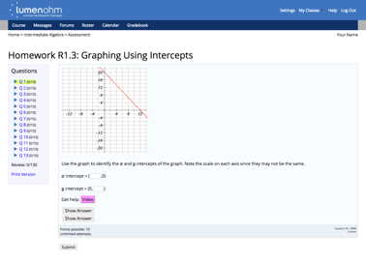
OHM Online Homework Manager
Large question bank
Algorithmic generation
Extensive video
Full OER content suite
Full suite of quantitative courses
$25
Notes:
Powered by OHM, OER math courses from Lumen Learning provide instructional content, online practice problems and assessments for many college math courses. Lumen courses combine the flexibility of open educational resources with the reliability, security, accessibility and ease-of-use you expect from an enterprise learning system. Used by thousands of students and instructors each term, Lumen courses are very affordable options.

Slide 17
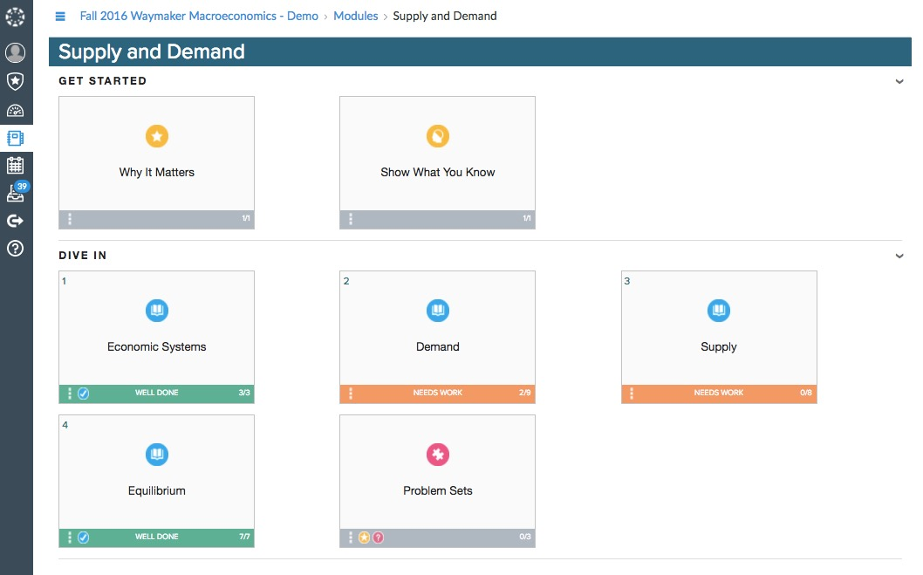
Waymaker Courses - Next Generation Personalized Learning
Personalized study plan
Highly interactive content
Messaging tools to create faculty-student connection
Data-driven interventions
Strong results for low-income students
$25
Notes:
Lumen’s Waymaker digital courseware combines curated OER content with human-centered personalized learning tools engineered to enhance student success. Waymaker’s personalized study plan develops students’ metacognitive abilities by providing them with relevant information and choices about their learning and real-time feedback to help them progress. Waymaker creates efficiencies for instructors to help them identify and help struggling students when and where needed.

Slide 18
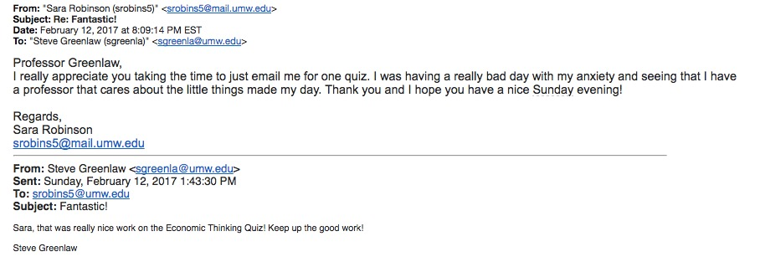
Waymaker Messaging Experience

Slide 19
Early Waymaker Results
(No difference for Waymaker)
Traditional
Traditional
Traditional
7,650 students, 4 different undergraduate courses, 7 institutions.
Notes:
Students who were Pell eligible and did not get to use Waymaker received a final grade 1/3 of a letter grade lower than their non-Pell eligible peers.
(These differences in final grade are statistically significant).
Students who were Pell eligible and did get to use Waymaker received the same final grades as their non-Pell eligible peers.
(There is no statistically significant difference in these grades.)

Slide 20
Learning Data: Waymaker Efficacy
Metric | Control | Waymaker
Drop | 34% | 10%
Withdraw | 9% | 10%
C or Better | 92% | 91%
Throughput | 55% | 73%
THROUGHPUT
% of day 1 students who pass the course
Develop
Learning Data Detail: Analysis includes 3889 students at Cerritos College during spring, summer and fall terms 2016. 1869 were in sections taught with Waymaker courses, and 2020 were in “control” sections using commercial publisher or OER alternatives.

Slide 21
Traditional
Traditional
Traditional

Slide 22
Waymaker and OHM Demo

Slide 23
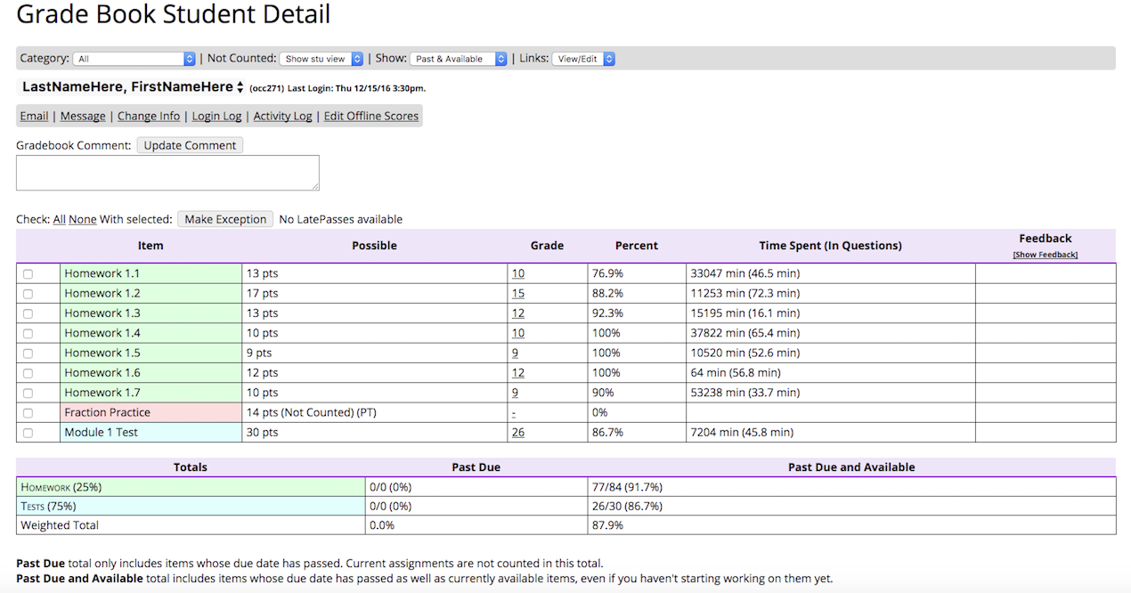
OHM Grade Book Student Detail
Develop
Notes:
What is Lumen

Slide 24
Waymaker Catalog (21 subjects)
COURSES
Introduction to Business Principles of Marketing Basic Reading & Writing Introduction to College Composition English Composition I Biology I (for Majors) Biology II (for Majors) Biology I (for Non-Majors) Psychology Business Management Arithmetic | Microeconomics Macroeconomics Elementary Algebra Intermediate Algebra Sociology College Success College Algebra Math for Liberal Arts Statistics Computer Applications for Managers
Develop
Notes:
Note: “Control” sections use a variety of required course materials. Some use commercial textbooks. Others use OER textbooks.

Slide 25
OHM Catalog (12 subjects)
 | COURSES
OHM | Arithmetic Beginning/Elementary Algebra Intermediate Algebra Math for Liberal Arts Introductory Statistics | College Algebra Pre-calculus Calculus I & II Pre-Algebra
Waymaker & OHM | Arithmetic Elementary Algebra Intermediate Algebra | College Algebra Math for Liberal Arts Statistics
Develop
Notes:
Note: “Control” sections use a variety of required course materials. Some use commercial textbooks. Others use OER textbooks.

Slide 26
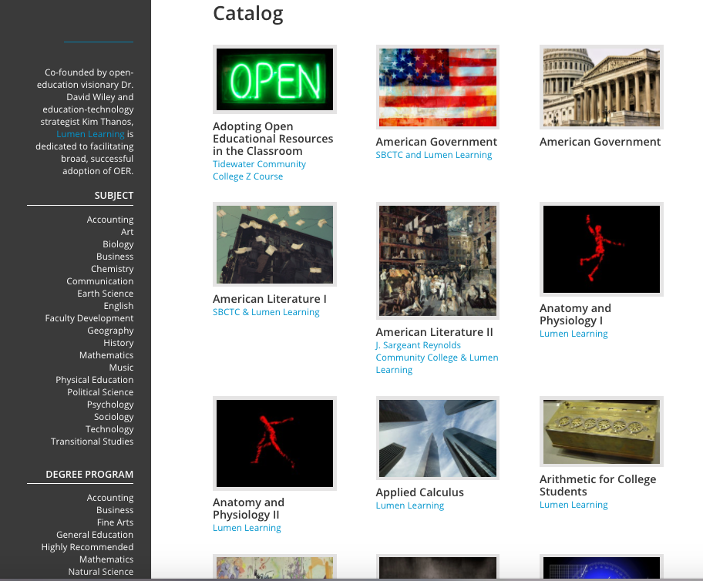
Candela Courses
Candela Course Catalog (78 subjects)
Candela

Slide 27
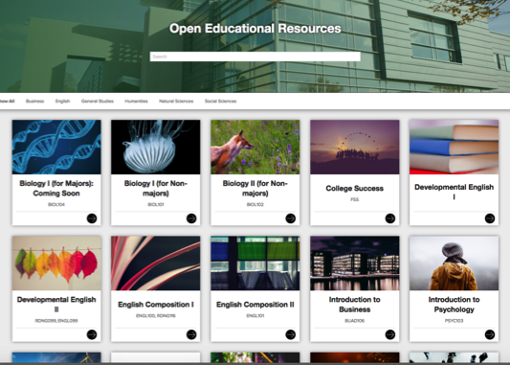
Find Your OER Course(s)
Learn More:
Request a Demo
Lumen Course List (PDF)
Public Course Catalog
Website: lumenlearning.com
Questions? Contact Us
Develop
Notes:
Many resources are available to help you learn more.

Slide 28
Lumen Benefits for Students
Affordable, low cost
Enriched content: text, video, online practice problems, simulations, etc.
Automatic day one access via your LMS
Learning design to improve student success
Retain electronic copies of course materials forever (PDF)
Convenient one-stop payment
Develop
Notes:
If you want to make the transition to OER, many choices are available to help you on that path. What’s different about working with Lumen Learning? It comes down to two basic things:

Slide 29
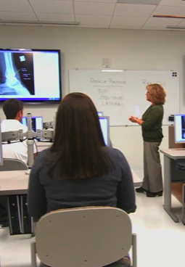
Lumen Benefits for Faculty
Select affordable course materials
Improve student success by ensuring day one access
Save time by starting with curated, outcome-aligned OER in your subject area
Customize to fit your students, classes, term length, learning outcomes
Use and adapt faculty-contributed assessments and supplemental resources
Simple, seamless access via your LMS
Develop
Notes:
If you want to make the transition to OER, many choices are available to help you on that path. What’s different about working with Lumen Learning? It comes down to two basic things: 1) well-designed and customizable OER course materials that are a better, simpler starting point, and 2) well-supported OER projects designed around your institution’s goals and priorities, along with the technical expertise to help you realize those goals.

