Slide 1


OER for Math: Lumen Online Homework Manager (OHM)
Creative Commons Attribution 4.0 License, Lumen Learning unless otherwise noted
Notes:
Session Outline:
What does Lumen offer in math?
Which courses are available?
How do I learn more?

Slide 2
Why OER?
Why are open educational resources a better choice for general education curriculum?
Affordability: dramatically and persistently cheaper than traditional publisher alternatives
Effectiveness: Research shows students perform as well or better using OER compared to non-OER alternatives
Control: Greater faculty control over curriculum; agility to make timely updates and improvements
Retain access: Students retain PDF/EPUB access. Forever.
Develop

Slide 3
Adopt
Lumen OHM offers:
A complete OER solution for math courses
Day one access
At a fraction of the cost students pay elsewhere
Blend
Customize
Develop
Notes:
Lumen has a complete solution for these math courses
We provide it at a fraction of the cost students would pay anywhere else, with day one access.
We are in discussions about system dollars paying for Lumen’s support for OER courses.
Transparent pricing and low cost: $25 per student enrolled in Lumen-supported courses.

Slide 4

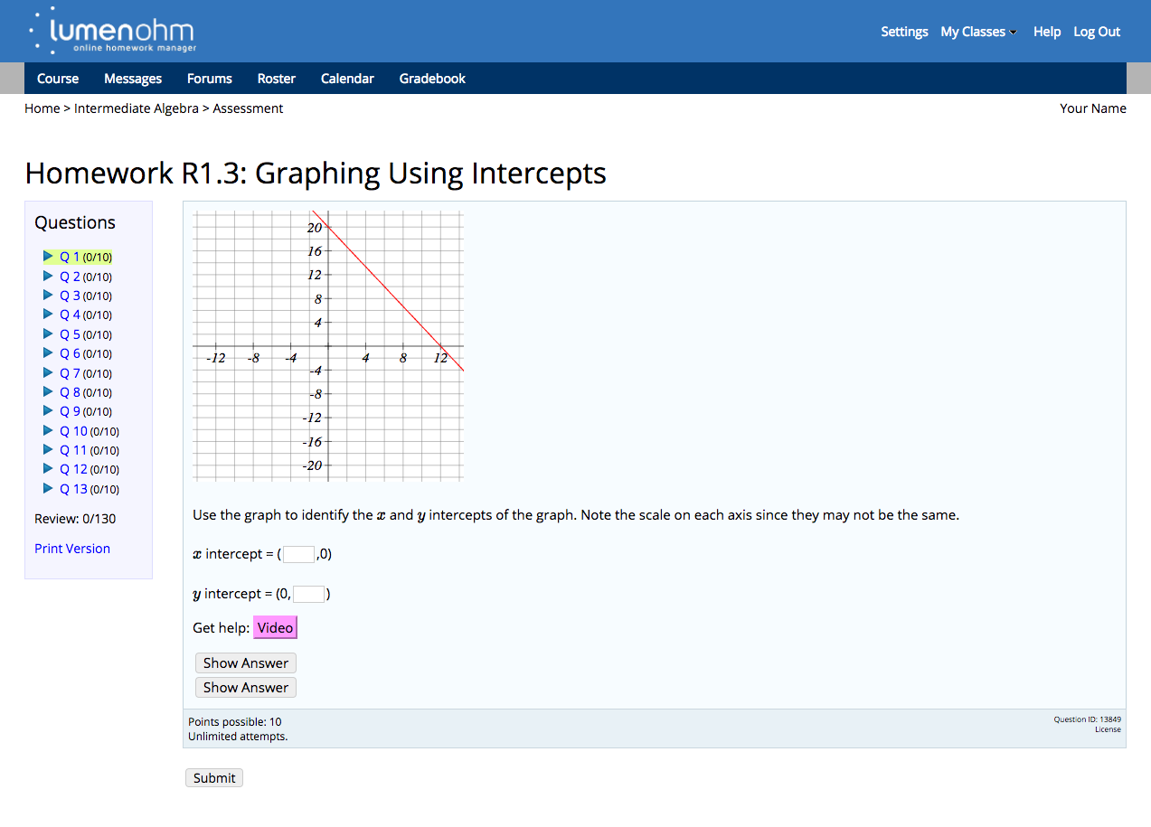
Online Homework System
Large bank of teacher-created questions
Many question types
Algorithmically-generated problems
LMS integration with grade return
Develop
Develop
Notes:
Lumen Online Homework Manager or OHM courses are a complete package containing open text, videos and algorithmically generated and graded assessments.
OER math courses from Lumen Learning provide instructional content, online practice problems and assessments for many college math courses. Lumen courses combine the flexibility of open educational resources with the reliability, security, accessibility and ease-of-use you expect from an enterprise learning system. Used by thousands of students and instructors each term, Lumen courses are very affordable options.

Slide 5
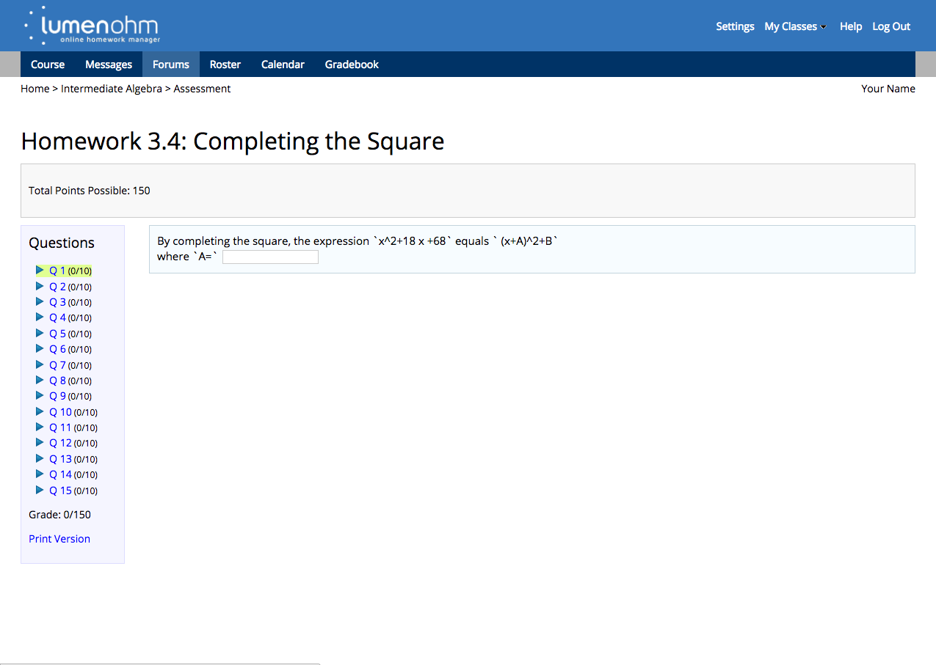
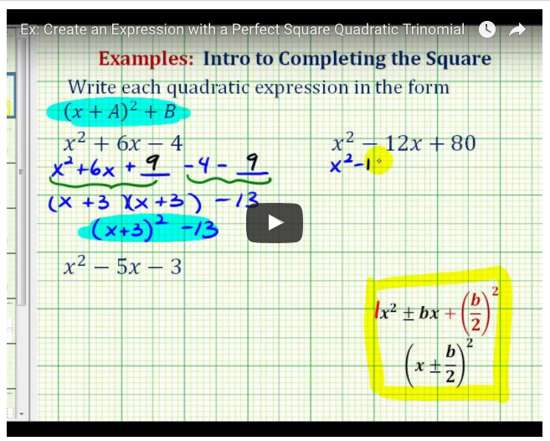
Enriched OER Content
Instructional text (including editable text options)
Video lessons and tutorials
Crowd-sourced library
Capability to include hints and directed feedback
Develop
Develop
Notes:
OER math courses from Lumen Learning provide instructional content, online practice problems and assessments for many college math courses. Lumen courses combine the flexibility of open educational resources with the reliability, security, accessibility and ease-of-use you expect from an enterprise learning system. Used by thousands of students and instructors each term, Lumen courses are very affordable options.

Slide 6
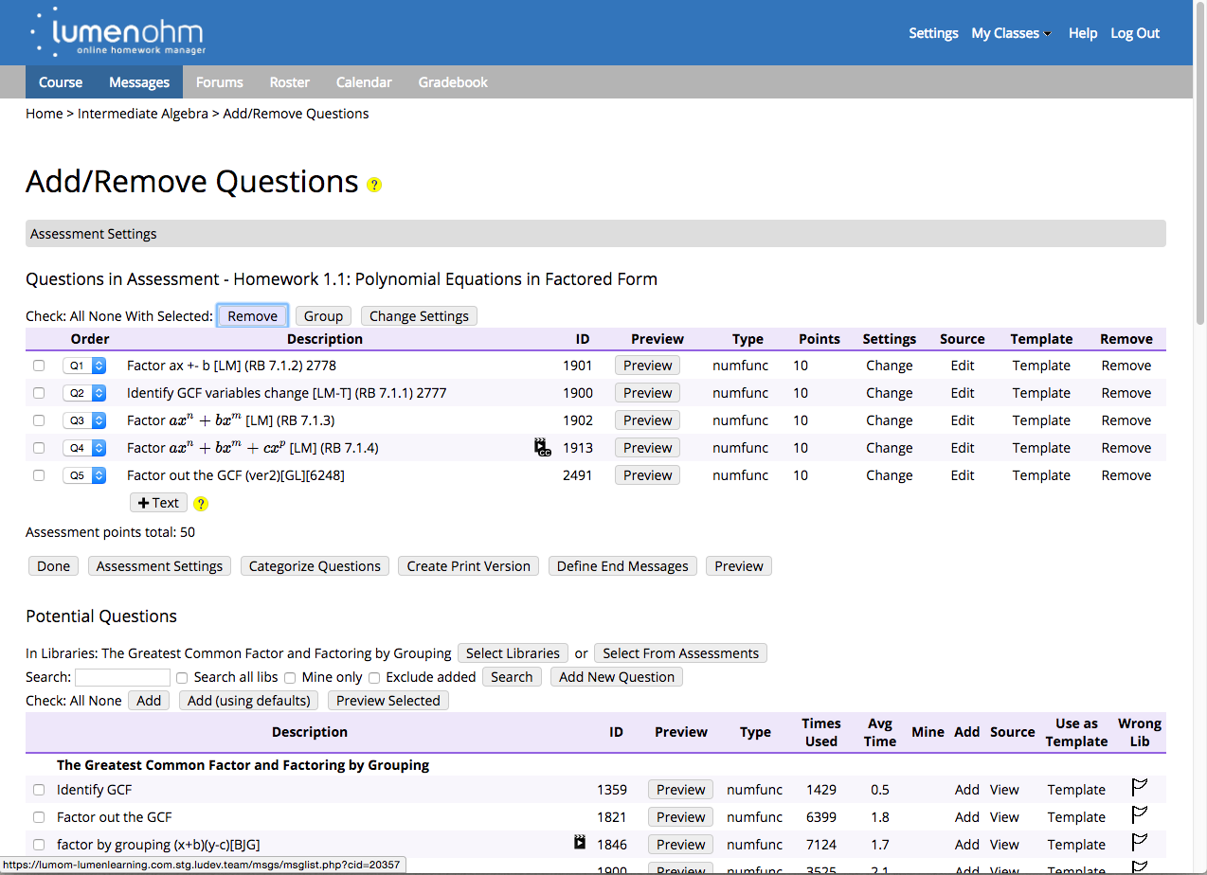
Customizable Course Design
Curated courses for easy starting point
Customize activities, questions, assessments
Align to to fit learning outcomes
Align to fit student needs, term length, etc.
Develop
Develop
Notes:
Curated, pre-built courses provide an easy starting point that aligns text, video lessons, problem sets and quizzes with learning outcomes. As you customize your course, you can tap into OHM’s huge library of teacher-created questions to choose those that work best for your students. Because its open, you can also create new items and contribute them back to the community. One of the most useful things that Lumen does is bring a kind of snowball model of OER development to faculty, so they are not staring into a Google search box trying to find small pieces to put together.

Slide 7
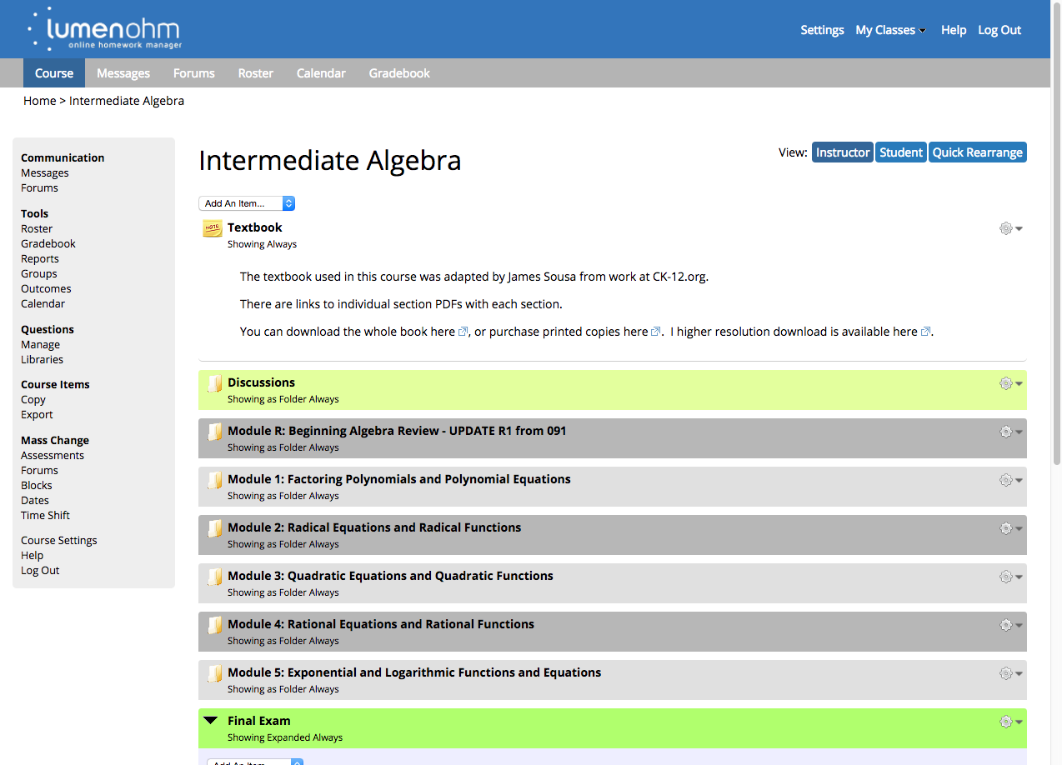
Affordable Access to Quality Content
Day one access for every student
Replace expensive publisher materials
$25 support fee per student (vs. $100-150)
12 high-enrollment college subjects

Slide 8
Lumen OER Improves Student Success
OER Courses
Traditional Courses
4% increase in passing rates
8% reduction in drops and W’s
18% more credits this term
22% more credits next term
Develop
Sample: 4,909 open course students, 11,818 traditional course students, 50 different undergraduate courses, 130 teachers, 8 institutions in 2014-2015 academic year.
Method: Quasi-experimental design with: Propensity Score Matching, Post Test Only.
Dependent variables: Completion; C or Better; Credits Enrolled This Term; Next Term, Independent variable: Textbook condition, 3 covariates: including age, gender, and race.
Notes:
These are results from research conducted among institutions that offer Lumen-supported OER courses, across 8 institutions, 50 courses and more than 15,000 students. Here, we’re comparing several student success metrics between OER courses (in red) and traditional courses that do not use OER (in blue). The evidence is compelling: OER courses saw significantly higher passing rates, significantly lower drops and withdrawal rates, and students registered for more credits in the current and next terms, which bodes well for college completion rates.
In a nutshell: Lumen offers OER math materials that are extremely flexible, cheaper and better for students.
When we’re working with institutions to adopt OER, we see better results
For VCCS Audience: We’ve worked with all 23 colleges across a range of different courses. When we work with you to adopt OER, it works. You will see better results. Stop by this afternoon to see what we’re doing and learn more. Sessions … ? [Sessions on Waymaker & Lumen OHM]

Slide 9
OHM Course List
Subject | OHM (static text) | OHM (editable text)
Pre-algebra / Arithmetic Elementary Algebra Intermediate Algebra College Algebra / Pre-Calculus I Trigonometry / Pre-Calculus II Math for Liberal Arts / Quantitative Reasoning Concepts in Statistics Introductory Statistics Business Statistics Business Calculus Calculus I Calculus II | Y Y Y Y Y Y Y Y Y Y Y Y | In progress Y Y Y Y Y Y Y Y
Develop
Notes:
Customizable template courses in many high-enrollment college subjects

Slide 10
Lumen Support Fee Pricing
$25 per student enrollment for all courses using Lumen OHM
Automatic, day one access for all students via LMS
Paid by student through bookstore/IncludED™, a course materials fee, or students can purchase an access code through the bookstore
No external textbook cost
No bookstore markup
Includes technical and faculty support
Training:
Dedicated workshop-style training available upon request for an additional fee. May be recommended for larger groups.
Develop

Slide 11

Why Lumen-supported Math?
Well-supported Faculty
Faculty-friendly training and ongoing support
Curated courses provide simple starting point
Flexible options to customize, edit, remix content
Sharing across collaborative customer community
Well-supported Learning Experience
Highly secure, reliable technical environment
Investment to meet accessibility standards
Seamless LMS integration and grade return
Strong support for wide-scale adoption
Develop
Notes:
If you want to make the transition to OER, many choices are available to help you on that path. What’s different about working with Lumen Learning? It comes down to two basic things: 1) well-supported faculty who enjoy a better, simpler starting point for the transition to OER, and 2) a well-supported technical environment and learning experience for your students.

Slide 12
Next Steps
Request a Lumen OHM demo
Ask your Follett representative
Ask Lumen Learning
Visit ohm.lumenlearning.com to:
Experience the student view
Request an instructor account to explore OHM, set up and customize a test course
Develop

Slide 13
Adopt
THANK YOU
Blend
Customize
Develop

