Slide 1


Waymaker Overview: Personalized Learning & OER
Creative Commons Attribution 4.0 License, Lumen Learning unless otherwise noted
Notes:
What does Lumen offer?
Is there something for me in my discipline/subject?
How do I learn more?

Slide 2
Why OER?
Why are open educational resources a better choice for general education curriculum?
Affordability: dramatically and persistently cheaper than traditional publisher alternatives
Effectiveness: Research shows students perform as well or better using OER compared to non-OER alternatives
Control: Greater faculty control over curriculum; agility to make timely updates and improvements
Retain access: Students retain PDF/EPUB access. Forever.
Develop

Slide 3
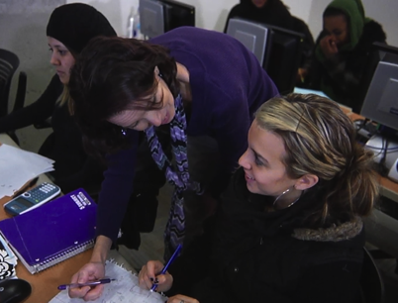
What is Waymaker?
For Students:
The best available curated OER wrapped in metacognitive supports to guide them towards mastery
For Faculty:
Recommendations and messaging tools to rapidly identify and help students who need support
Develop
Notes:
Lumen’s Waymaker digital courseware combines curated OER content with human-centered personalized learning tools engineered to enhance student success. Waymaker’s personalized study plan develops students’ metacognitive abilities by providing them with relevant information and choices about their learning and real-time feedback to help them progress. Waymaker creates efficiencies for instructors to help them identify and help struggling students when and where needed.

Slide 4
Adopt
Waymaker gives students automatic day one access to OER course content
inside the LMS.
Blend
Customize
Develop

Slide 5
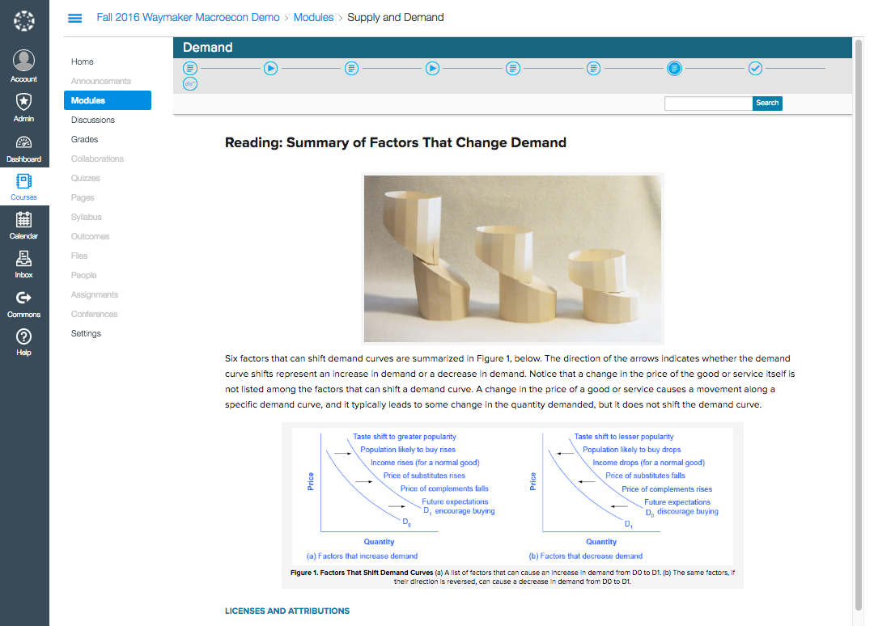
Adopt
Blend
Customize
Develop
Notes:
Lumen curates the best available OER content. We align it with learning outcomes and organize it into a course structure. Faculty members have the ability to customize and reorder content, to ensure it fits their learning outcomes, term length, and so forth. OER content includes complete text, video, simulations and other interactives, sample discussion forums, sample human-graded performance assessments, customizable quizzes and self-checks, PowerPoint slides, and so forth. We use an LTI connection to embed course content in the LMS.

Slide 6
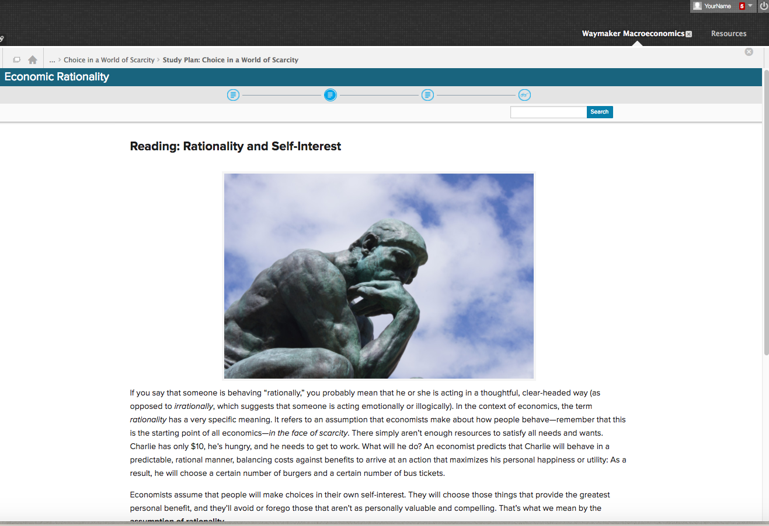
Adopt
Blend
Customize
Develop
Notes:
Lumen curates the best available OER content. We align it with learning outcomes and organize it into a course structure. Faculty members have the ability to customize and reorder content, to ensure it fits their learning outcomes, term length, and so forth. OER content includes complete text, video, simulations and other interactives, sample discussion forums, sample human-graded performance assessments, customizable quizzes and self-checks, PowerPoint slides, and so forth. We use an LTI connection to embed course content in the LMS.

Slide 7
Adopt
Waymaker provides students with great OER content in a personalized study plan.
Blend
Customize
Develop

Slide 8
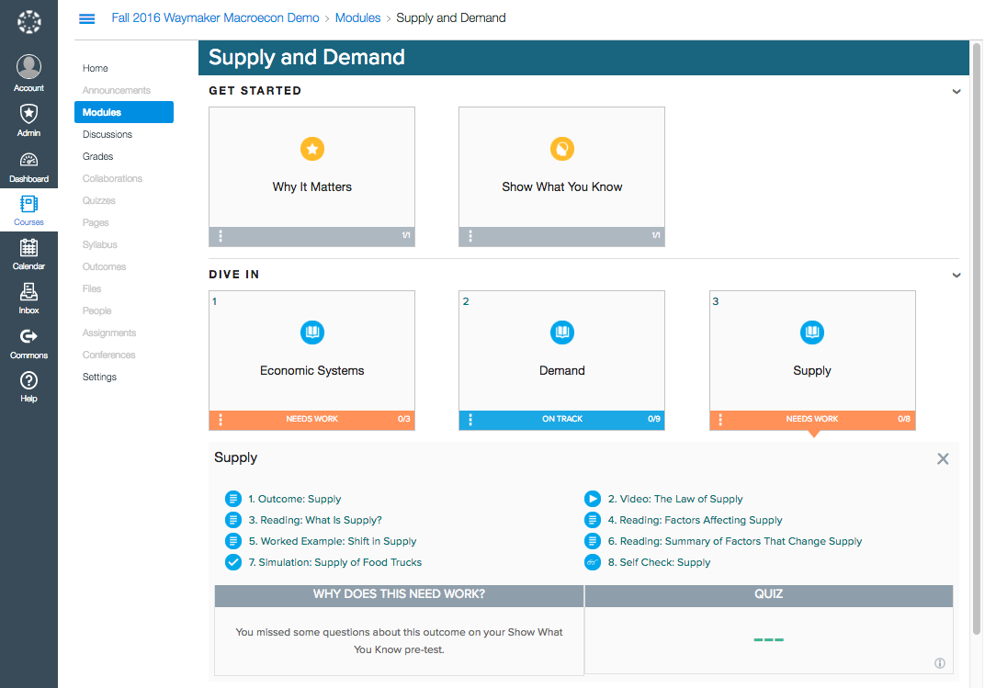
Adopt
Blend
Customize
Develop
Notes:
Data from pretests, self-checks, and quiz attempts are reflected back to students in study plan view with personalized signposts to show them where they are struggling and should focus their attention and energy. All the quiz and self-check questions are customizable.

Slide 9
Adopt
Waymaker increases communication and individualized connection with students.
Blend
Customize
Develop

Slide 10
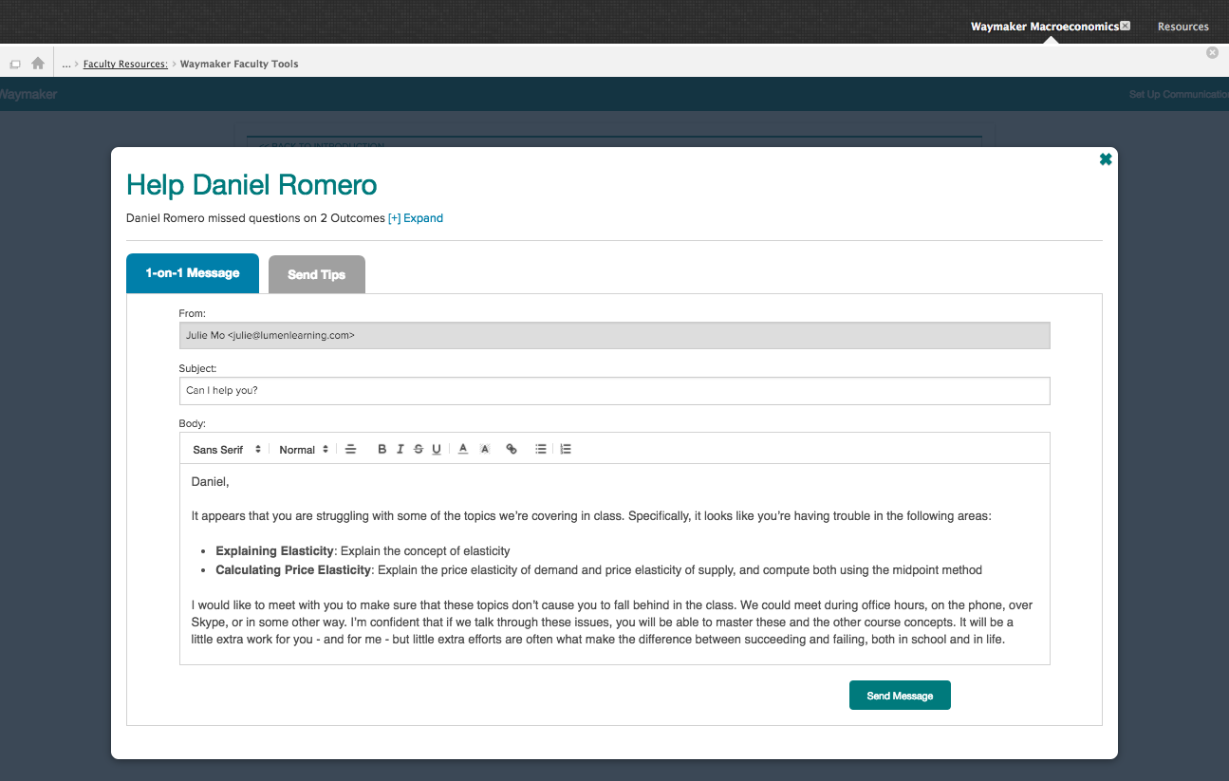
Recommended Message: Offer Help
Develop
Notes:
Waymaker provides recommendations about who needs help and what they’re struggling with. It also has pre-built template messages for instructors to quickly and easily send a message to offer help.

Slide 11
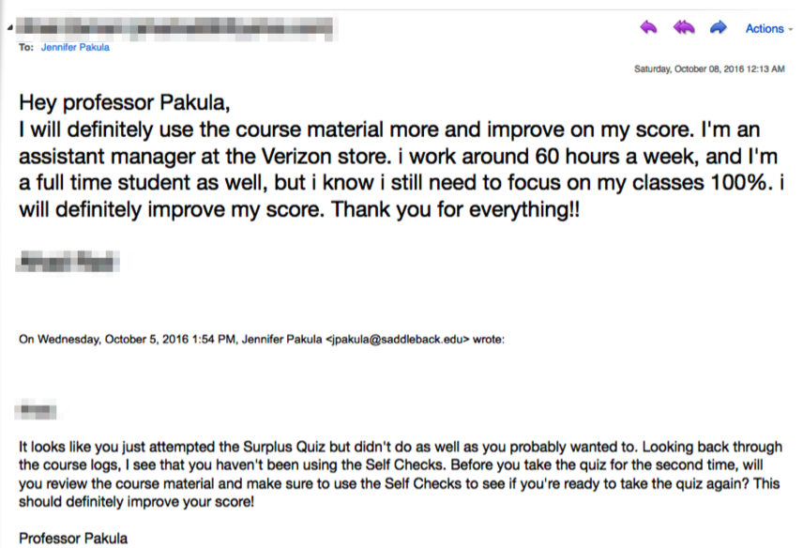
Automated Message: Study Tips
Student Response
Waymaker
Automated Message
Develop
Notes:
Actual email message exchange during fall term 2016 in a Waymaker Macroeconomics course. Faculty members have the option to set up automated messages the system sends out on their behalf at appropriate moments to provide helpful guidance and encouragement to students based on their academic performance and how they are using the course materials.

Slide 12
Adopt
Waymaker helps faculty provide encouragement and motivation.
Blend
Customize
Develop

Slide 13
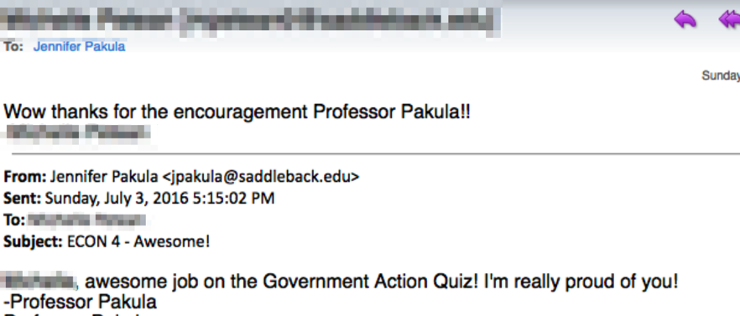
Automated Message: Well done!
Student Response
Waymaker
Automated Message
Develop
Notes:
Actual email message exchange during fall term 2016 in a Waymaker Macroeconomics course. Faculty members have the option to set up automated messages the system sends out on their behalf at appropriate moments to provide helpful guidance and encouragement to students based on their academic performance and how they are using the course materials.

Slide 14
Adopt
Waymaker supports students becoming better learners.
Blend
Customize
Develop
Notes:
Lumen has promising efficacy data from multiple institutions and thousands of students using Waymaker OER courses during summer-fall 2016.

Slide 15
Learning Data: Waymaker Efficacy
Waymaker can erase
the “Pell Penalty”
Putting Pell eligible students on equal footing with their non-Pell eligible peers
Average Final Grades
Non-Pell eligible students
2.69
Pell eligible students using Waymaker
2.67
Pell eligible students not using Waymaker
2.33
Develop
Learning Data Detail: Study examined fall 2016 learning data for 5,622 students at 8 institutions enrolled in Introduction to Business courses. Analysis compared students’ final grades in sections using Waymaker Introduction to Business vs. those using commercial publisher or OER alternatives.
Notes:
Students who were Pell eligible and did not get to use Waymaker received a final grade 1/3 of a letter grade lower than their non-Pell eligible peers. (These differences in final grade are statistically significant).
Students who were Pell eligible and did get to use Waymaker received the same final grades as their non-Pell eligible peers. (There is no statistically significant difference in these grades.)

Slide 16
Learning Data: Waymaker Efficacy
THROUGHPUT
% of day 1 students who pass the course
Metric | Control | Waymaker
Drop | 34% | 10%
Withdraw | 9% | 10%
C or Better | 92% | 91%
Throughput | 55% | 73%
Develop
Learning Data Detail: Analysis includes 3889 students at Cerritos College during spring, summer and fall terms 2016. 1869 were in sections taught with Waymaker courses, and 2020 were in “control” sections using commercial publisher or OER alternatives.

Slide 17
Adopt
Waymaker integrates with any major learning management system.
Blend
Customize
Develop
Notes:
Seamless LMS integration, including single sign-on and grade return for graded quizzes

Slide 18

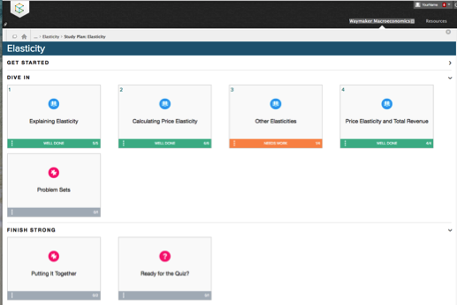
Blackboard LMS

Slide 19
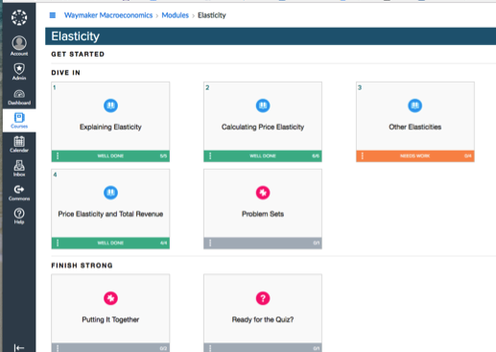
Canvas LMS
Develop

Slide 20
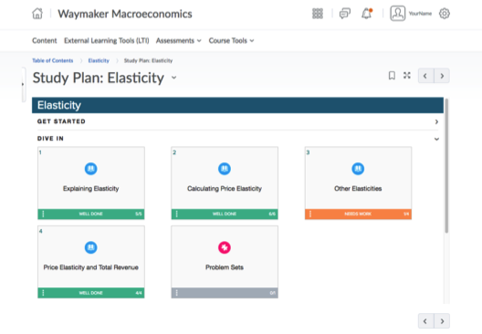
D2L Brightspace
Develop

Slide 21
Waymaker Catalog (21 subjects)
COURSES
Introduction to Business Principles of Marketing Basic Reading & Writing Introduction to College Composition English Composition I Biology I (for Majors) Biology II (for Majors) Biology I (for Non-Majors) Psychology Business Management | Microeconomics Macroeconomics Arithmetic Elementary Algebra Intermediate Algebra Sociology College Success College Algebra Math for Liberal Arts Statistics Computer Applications for Managers
Develop
Notes:
There are 21 Waymaker courses available.

Slide 22
Lumen Support Fee Pricing
Waymaker courses:
$25 per student enrollment
Automatic, day one access for all students via LMS
Paid by student through either IncludED™, a course materials fee, or students can purchase an access code through the bookstore
No external textbook cost
No bookstore markup
Includes technical and faculty support
Training:
Dedicated workshop-style training available upon request for an additional fee. May be recommended for larger groups.
Develop

Slide 23
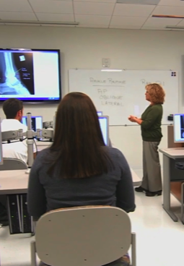
The Lumen Difference
Well-designed OER Courses
Curated, outcome-aligned OER in many subjects
Learning design with student success focus
Supplemental resources contributed by faculty
Use content as is or make it your own
Data-driven improvements
Well-supported OER Initiatives
Projects progress more quickly towards institutional goals for OER
Faculty-friendly training and support
Seamless access via your LMS
Large, collaborative customer community
Develop
Notes:
If you want to make the transition to OER, many choices are available to help you on that path. What’s different about working with Lumen Learning? It comes down to two basic things: 1) well-designed and customizable OER course materials that are a better, simpler starting point, and 2) well-supported OER projects designed around your institution’s goals and priorities, along with the technical expertise to help you realize those goals.

Slide 24
Next Steps
Request a Waymaker demo from
Ask your Follett representative
Ask Lumen Learning
Visit lumenlearning.com/follett to
Learn more about Waymaker
Request demo course access for hands-on review
Develop

Slide 25
Adopt
THANK YOU
Blend
Customize
Develop

